Slide 1



MODERN SLAVERY
Impact on Young People and Children
Notes:
Welcome the class to the session

Slide 2
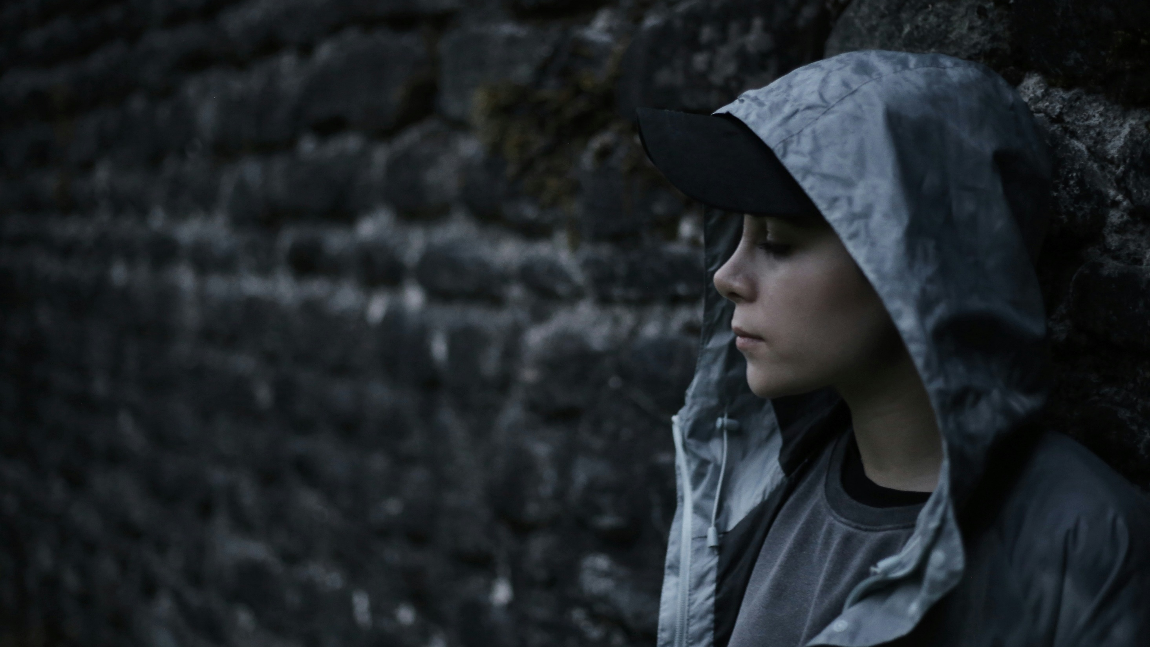
What is Modern Slavery?
Why is this a problem?
How does it impact you, your family and friends?
How can you protect yourself and others?
Notes:
This is what you will be covering in the next hour.

Slide 3

Some of the content we discuss may be distressing.
Look after your own emotional wellbeing.
If you want to leave, please do, BUT talk to a staff member or find someone to offer support before leaving here today.
Notes:
This is a key point to emphasise . There are a number of videos and case studies which trigger memories of bad experiences in the past or just might be upsetting because of the nature of the content and information. Children and young people should be reassured that it is OK to leave the room if they need time out or need to contact someone to process what is going on for them.

Slide 4

What do you think of when you hear the term Modern Slavery?
Notes:
Ask the children/young people for their thoughts

Slide 5
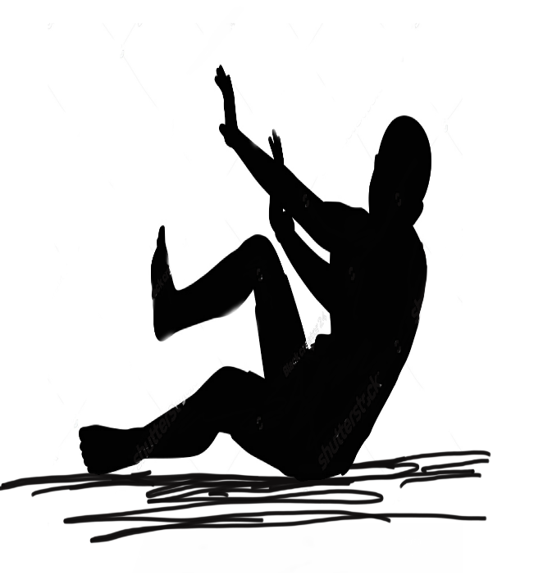

Overview of Introduction
Introduction to Modern Slavery
International definition for human trafficking
What is done: e.g. recruitment, transportation, transfer, harbouring or receipt of persons
WHAT
How it is done: e.g. the threat of use of force, coercion, abduction, fraud, deception, abuse of power or position of vulnerability
HOW
WHY
Why it is done: e.g. sexual exploitation, forced labour or services, servitude, criminal activity
Notes:
Umbrella term of modern slavery. HT under that umbrella as above. Explain slavery and servitude also under the same umbrella term – hold over someone, sense of ownership, do not need have that movement element as with HT.

Slide 6
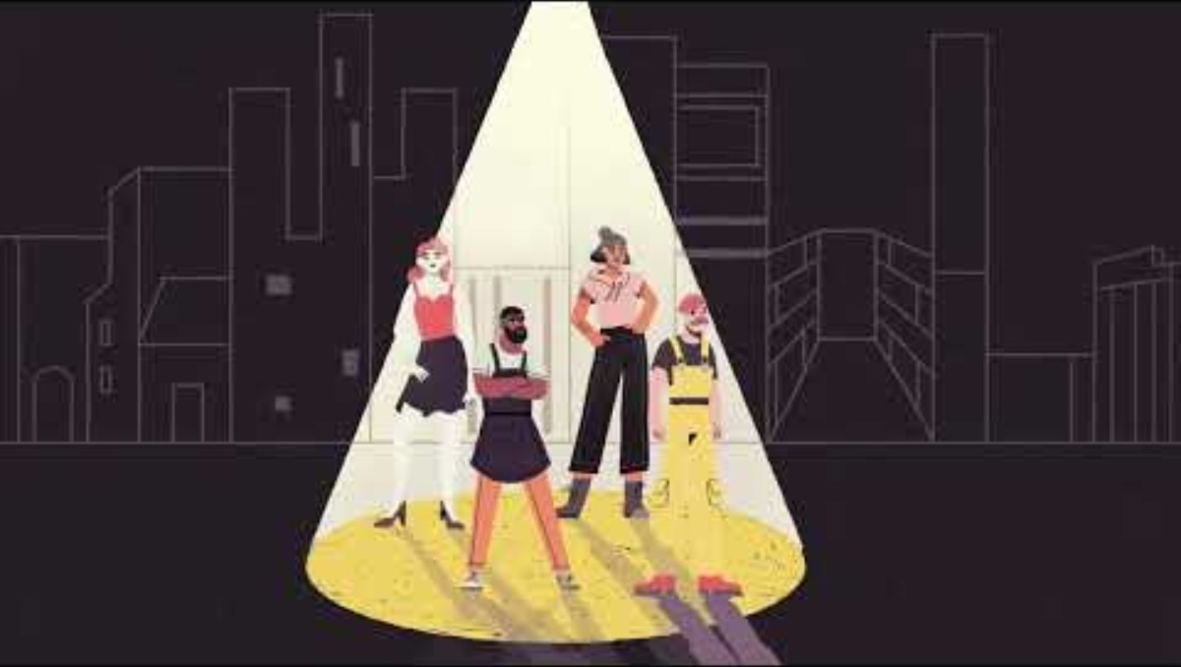
Notes:
This 3 minute film is an excellent insight into the various forms of modern slavery and the impacts. Ask the children/young people to look out for the different forms and impacts as they watch the film.

Slide 7
Discussion
What struck you about this video?
How does modern slavery impact people?
What are the different forms of modern slavery?
Notes:
Spend about 3 minutes on this feedback
Impacts – disillusionment, loss of freedom, bad treatment, fear, shame
Forms of slavery –
labour exploitation including nail bars and cleaners
Sexual exploitation
Dealing and trafficking

Slide 8
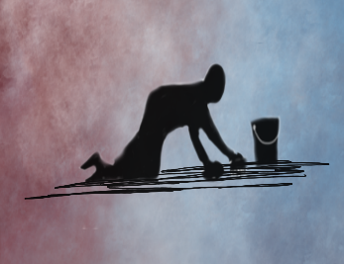
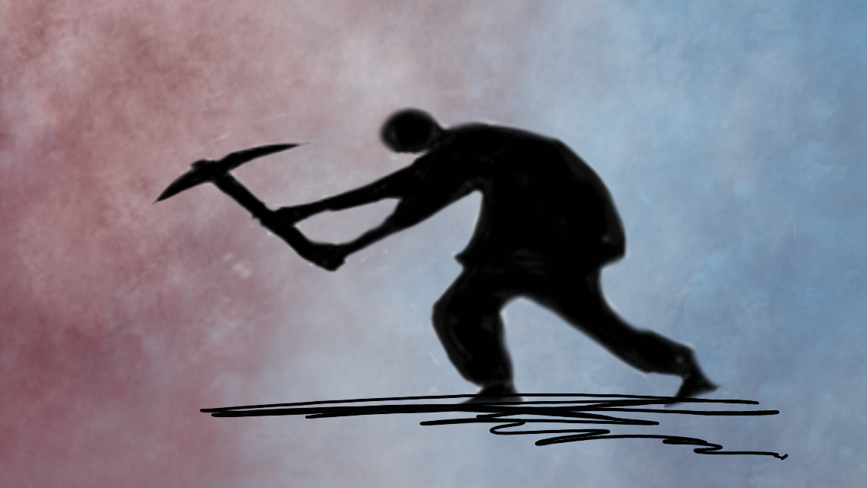
Forms of modern slavery
Forced to work in a private household.
Exploited by a partner, relative ‘employer’.
Childcare, cleaning, ironing and all household tasks.
Long hours, little to no pay.
Domestic servitude
Made to work long hours, in hard conditions.
Typical locations can include, constructions sites, car washes, care homes, nail salons.
No training or equipment.
Forced to hand over wages to traffickers.
Labour exploitation
Notes:
There are four main forms of exploitation in the UK. You are now going to say a bit about each. Information can also be found in the Facilitators Notes
Domestic Servitude Domestic servitude in the UK is a form of modern slavery where individuals, often women and children, are forced to work in private households under coercive conditions. The National Referral Mechanism reported hundreds of potential victims of domestic servitude annually, highlighting the urgent need for stronger protections, awareness campaigns, and support systems to address this hidden crime and safeguard the rights of affected individuals.
Labour exploitation Labour exploitation is a serious issue in the UK, where individuals, including children, are subjected to unfair working conditions, low wages, and excessive hours. Many victims are trapped in sectors such as agriculture, construction, and hospitality, often facing threats or coercion that prevent them from leaving. Children are particularly at risk, as they may be forced into work instead of attending school, depriving them of their education and future opportunities.

Slide 9
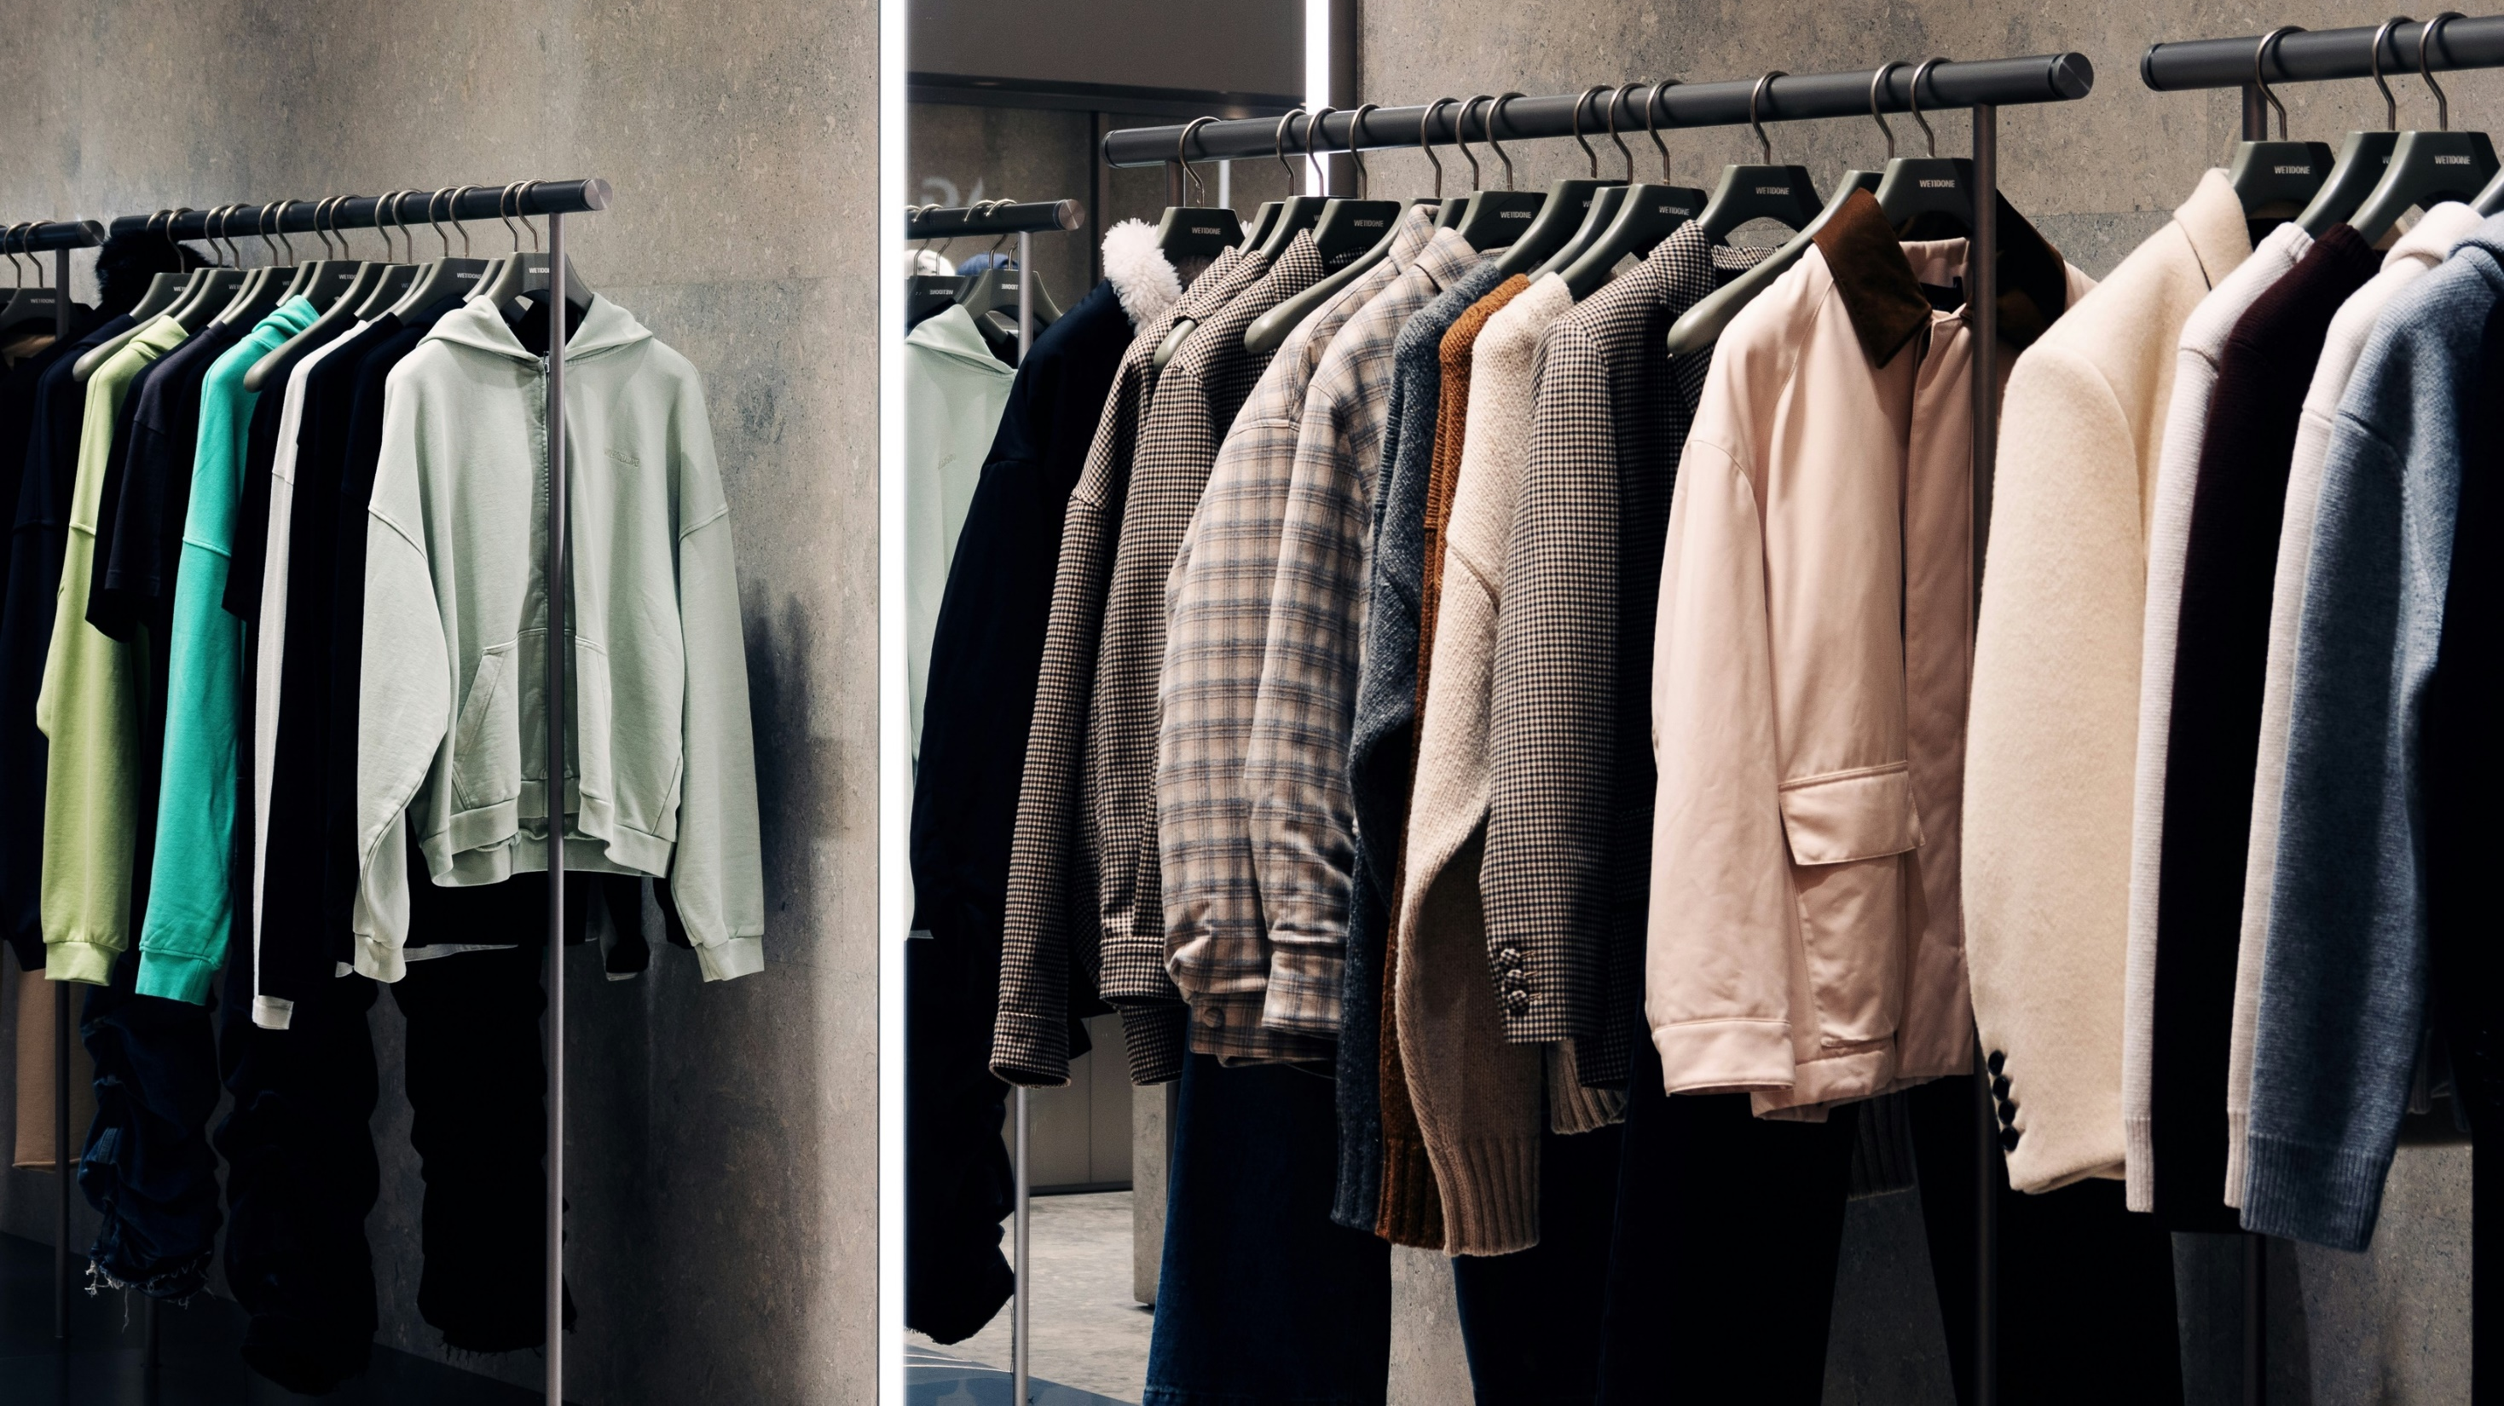
Clothes Shopping
Who has bought items of clothing online?
Boohoo Fashion Company facing modern slavery investigation after reports are revealed where workers in Leicester were paid as little as £3.50 an hour.
Do you stop and think about where the items had come from, who had made them, in what conditions or why they were being sold so cheaply?
What can we as buyers do differently?
Notes:
Read the narrative from the facilitators notes and ask the questions

Slide 10
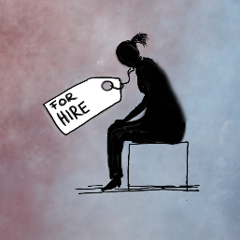
Forms of modern slavery
Non-consensual and abusive sex acts
Can have the appearance of consent but coerced
Child sexual exploitation by group or individual
Sex work in fixed or changing location
Trafficking for personal gratification
Sexual Exploitation
Notes:
There are four main forms of exploitation in the UK. You are now going to say a bit about each. Information can also be found in the Facilitators Notes
Domestic Servitude Domestic servitude in the UK is a form of modern slavery where individuals, often women and children, are forced to work in private households under coercive conditions. The National Referral Mechanism reported hundreds of potential victims of domestic servitude annually, highlighting the urgent need for stronger protections, awareness campaigns, and support systems to address this hidden crime and safeguard the rights of affected individuals.
Labour exploitation Labour exploitation is a serious issue in the UK, where individuals, including children, are subjected to unfair working conditions, low wages, and excessive hours. Many victims are trapped in sectors such as agriculture, construction, and hospitality, often facing threats or coercion that prevent them from leaving. Children are particularly at risk, as they may be forced into work instead of attending school, depriving them of their education and future opportunities.

Slide 11

Too good to be true
What would you do if someone said you could earn £5000 for a day’s work?
Notes:
Read the narrative in the facilitator’s notes to the class and discuss the questions with the class.

Slide 12
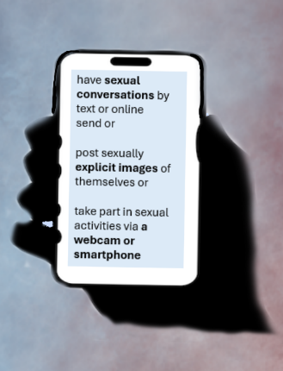
Forms of modern slavery
have sexual conversations by text or online
send or post sexually explicit images of themselves or
take part in sexual activities via a webcam or smartphone
When sexual exploitation happens online, young people may be persuaded or forced to:
Online Sexual exploitation
Notes:
Child sexual exploitation online
Abusers sometimes use the threat of sharing images, videos or copies of conversations to make young people do things they don’t want to do. This might include forcing a young person to pay them money or take part in further sexual activity. This is sometimes referred to as sexually coerced extortion or ‘sextortion

Slide 13
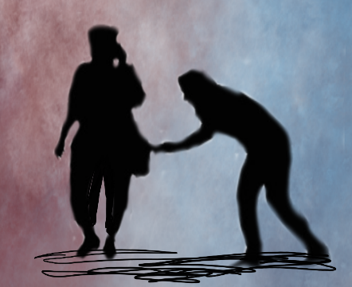
Forms of modern slavery
Forced to participate in illegal activities: pick-pocketing, shop-lifting, cannabis cultivation, begging
Financial exploitation
Forced to be part of a County Lines networks
Criminal Exploitation
Notes:
Criminal exploitation involves the manipulation of individuals, including children, to engage in illegal activities, often for the benefit of organized crime groups. Victims may be coerced into drug trafficking, theft, or sexual exploitation, frequently facing threats and violence that trap them in a cycle of abuse. Children are lured with promises of money, friendship, or a sense of belonging. Reports from law enforcement indicate a troubling rise in cases of child criminal exploitation. IN 2019, the big three forms of exploitation were dom servitude, sexual exploitation and labour exploitation. It is now the case that the main from of exploitation is criminal exploitation and his largely due to the prevalence of county lines drug trafficking all over the country.

Slide 14
How to spot modern slavery
Possible indicators
No passport or ID
Movement controlled
Limited social contact/isolated
Restricted freedom
Controlled by another/in fear
Poor and/or inappropriate language skills
Reluctant to give details of accommodation
Behaviour
Bonded by debt
Money deducted from salary for food or accommodation
Dependent on others
Finances
Dishevelled/lack of access to good personal hygiene
Unexplained injuries
Substance abuse
Appearance
Please note that this is not an exhaustive list
Notes:
This is not an exhaustive list.
Illegal entrant
Poor standard accommodation
Threats of being handed over to authorities
Working in location likely to be involved in exploitation

Slide 15

Exercise - How does it feel?
Please close your eyes and listen to the statements.
Start to imagine you are a young person wanting a better life and needing to get money to your family back home.

Slide 16
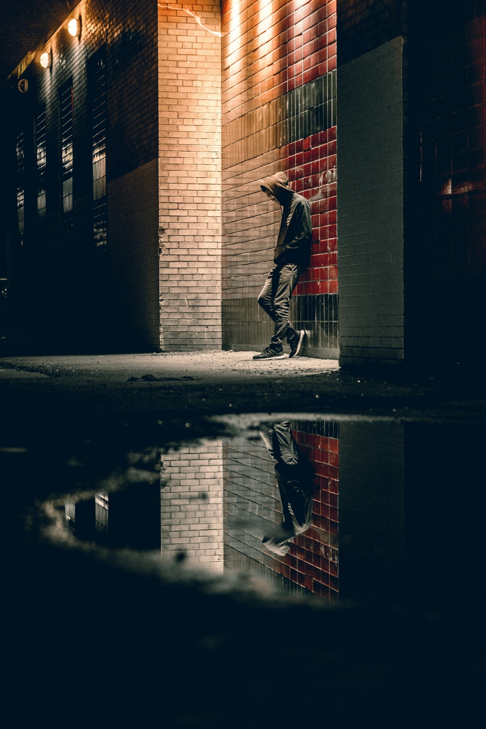
INTRODUCTION TO COUNTY LINES
What do you know about County Lines?
Notes:
Ask the children/young people what they know about county lines – have they seen any relevant TV programmes or come across it online. Some may have personal experience.
New videos which have =been added to the National County Lines Coordination Centre’s YouTube channel https://youtube.com/playlist?list=PLPTnOBOIBBuydzgBai4r6JP3SRfa8RIMd&si=dX4W8xVVsRvwoJwu

Slide 17
Introduction to County Lines
Town
City
‘County Lines is a term used when drug gangs from big cities expand their operations to smaller towns and rural areas via dedicated phone lines, often using violence to drive out local dealers and exploiting children and vulnerable people to sell drugs.’
Town
Town
City
Town
In the last few years County Lines has become one of the most common forms of modern slavery in the UK.
Town
Town
Town

Slide 18
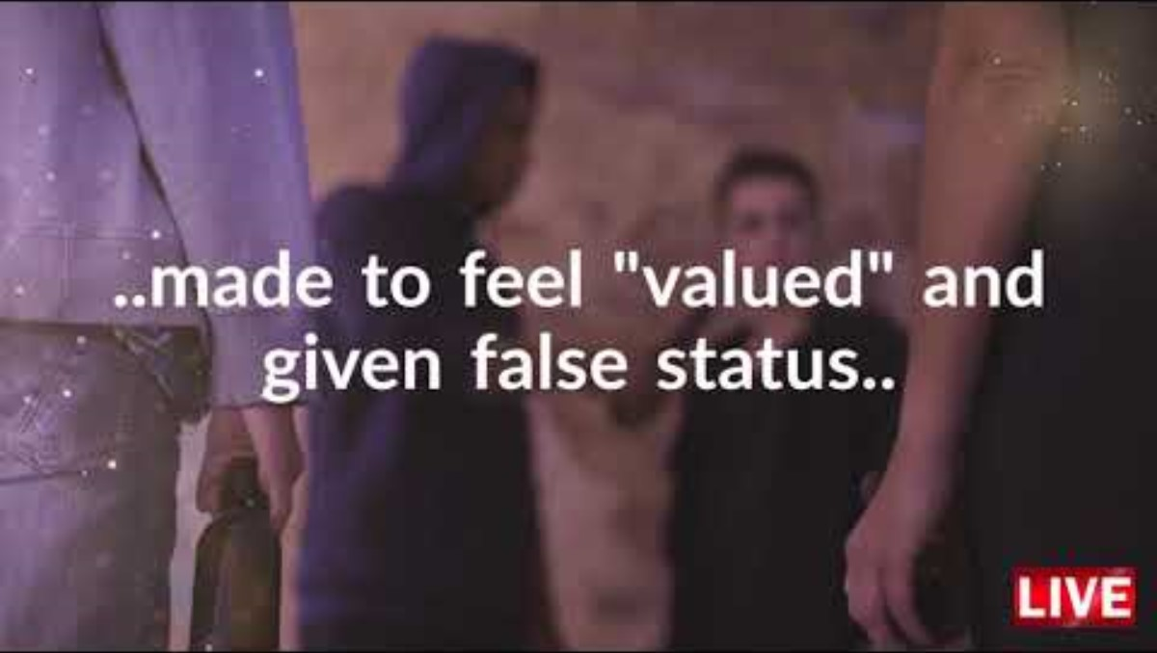
Notes:
This is a 3 minute film which gives a good overview of the nature of county lines,
Ask for any insights or feelings after watching this

Slide 19
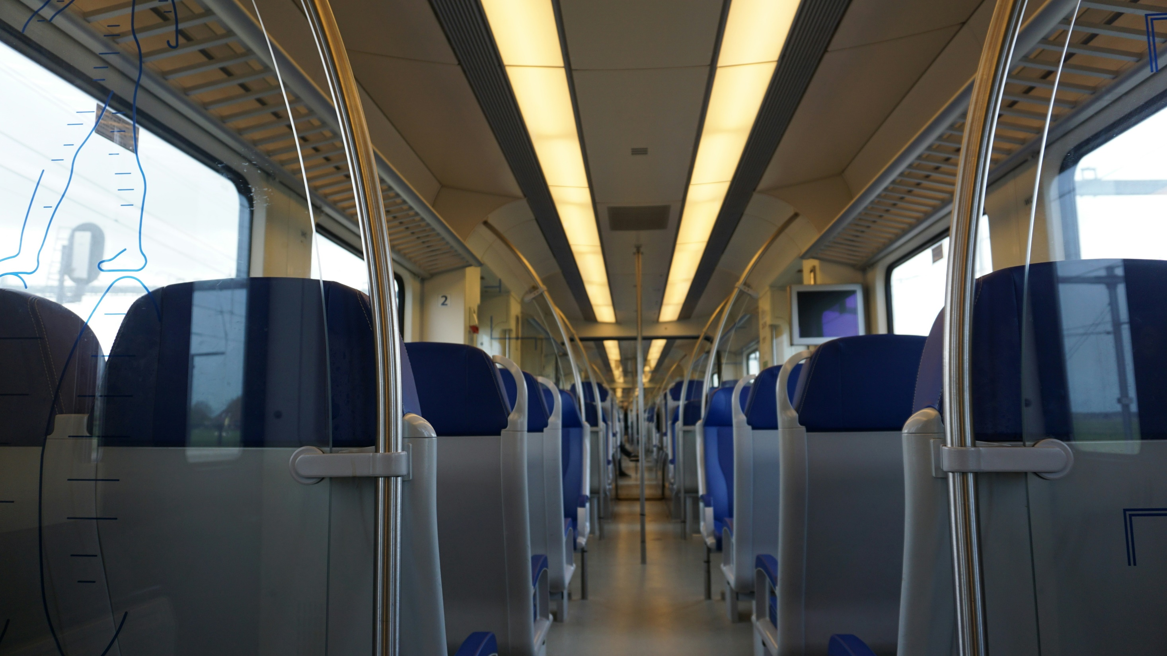
Case Study: County Lines
Notes:
Read the narrative from the Facilitator’s Notes and then discuss with your class how they felt as you were reading. Do they think this could happen to them? How could they make sure this does not happen to them? You could divide them into smaller groups to talk about their feelings before sharing their thoughts with the whole class.

Slide 20
County Lines refers
to phone line – used
by the OCG.
They send bulk messages to the market. Customers place orders via the line controlled by the line holder and orders are despatched by the runners (children).
£500m turnover. £800,000 profit for any one line
Source: NCA Annual Assessment released 2019
Boys are most likely to be involved
but this is changing with
girls being less
likely to arouse suspicion.
The drugs are
mainly crack
cocaine and heroin.
Children between 14 – 17 are mostly targeted but they can be as young as 6.
It can be any young person not doing so well at school or with problems at home and may be looking for some kind of belonging.
Notes:
Read these key facts out as they appear. Stress the final point that it can be anyone. Recent research has shown that there has been an increase in middle class, and even affluent young people being caught up in it. Most of the grooming now is done on line.

Slide 21
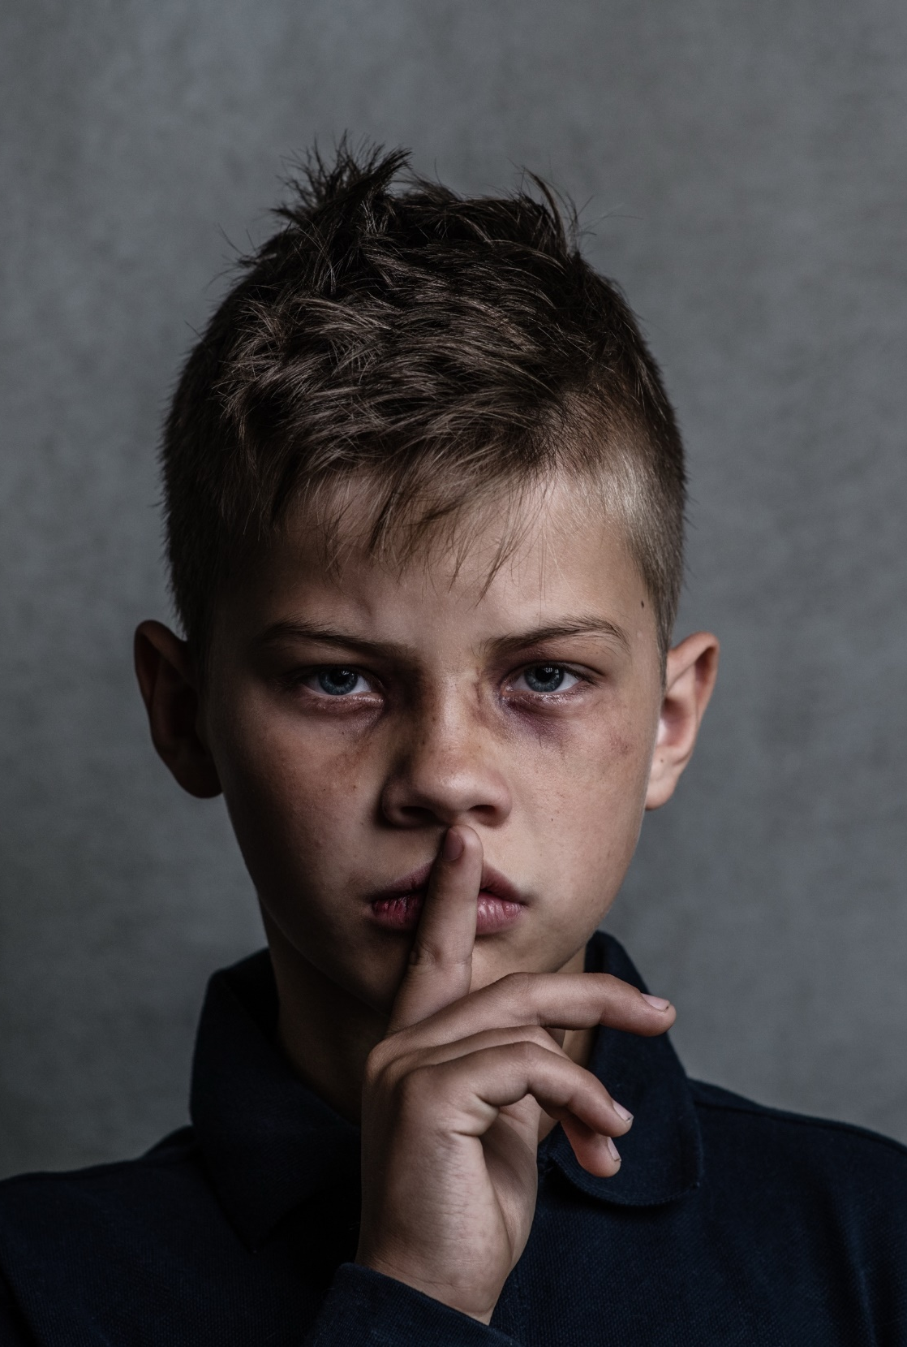
In what ways are children and young people vulnerable to being caught up in modern slavery?
Notes:
Ask the young people why they think they may be more vulnerable than an adult perhaps?

Slide 22

You may not feel it, but children and young people are used because you are easier to manipulate.
You can be more easily deceived into working for little or no pay and are less likely to be detected.
Notes:
You could also add that there is a mental health crisis with regard to young people these days. Self esteem can be low in this social media culture where young people feel they can’t compete with others. It can help their self esteem if they feel they belong to something and becoming part of gang can satisfy that need.

Slide 23
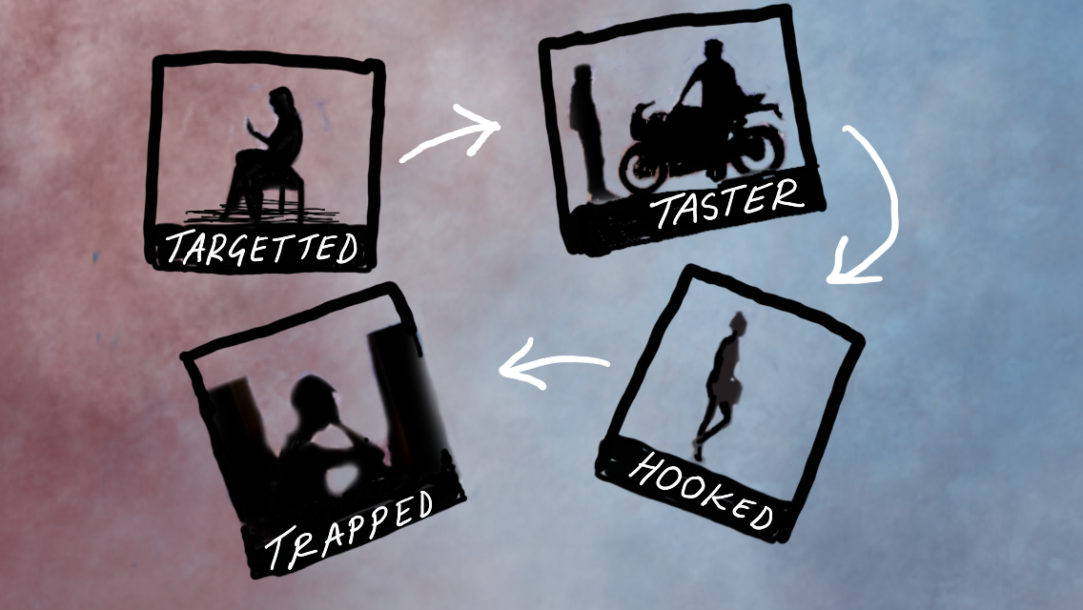
Stages of Recruitment
Notes:
This is a useful model to see how young people are drawn in to modern slavery, particularly county lines and sexual exploitation. But it is just a model and all models are fallible. Not all children will go through all the stages. Sometimes the trapped stage happens very quickly.

Slide 24
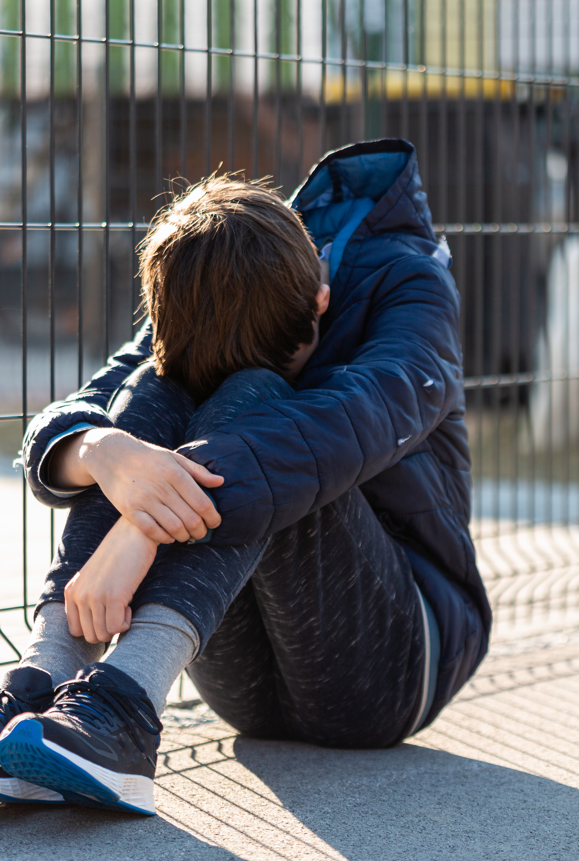
Targeting
This is when an exploiter targets a young person who is vulnerable. Exploiters pick their targets based on things like age, strength or situation.
Observing a young person
Finding out vulnerabilities
Glamorising their lifestyle
Gaining trust
Notes:
The way children are targeted is changing all the time in line with advances in technology.
Key places where gangs target, approach and manipulate vulnerable young people include schools and social care spaces, street grooming and increasingly digital channels including social media, private chat apps and online gaming. Research has shown that the majority of targeting and grooming is on Snapchat. But also online gaming platforms are used – children are offered gaming credits to put them into debt bondage.

Slide 25
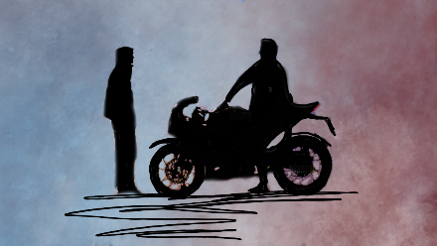
Taster
This stage is where an exploiter might try to get a young person used to their lifestyle or train them up in what they’re doing.
• Gifts and rewards
• Offer of protection
• Sense of belonging
Notes:
At this stage an exploiter might:
• Give a young person gifts and rewards, e.g. trainers, mobile phone,
E-scooter, X box etc
• Include them in their activities
• Offer a young person protection
• Give them a sense of belonging
• Introduce a young person to more established members of their gang

Slide 26

Hooked
Bigger role
More responsibilities
Drugs, alcohol and sexual behaviour
Favours, secrets
This is the stage where an exploiter will make a young person feel like they’re an important member of their gang, even though they’re just exploiting them.
Notes:
At this stage a young person might
• Be given a bigger role in the group (eg people running for them).
• Get more responsibilities within the group eg more money.
• Engage in activities such as drugs, alcohol and sexual behaviour
• Be asked for favours/to keep secrets/ to recruit others to the gang

Slide 27

Trapped
Now a young person feels dependent on the group, their relationship with their exploiter may start to become unpleasant, as their exploiter’s true intents or character is revealed.
Blackmail/fake mugging
Physical violence and sexual assaults
Shaming and guilt and Isolation
Humiliation
Drug addiction
Notes:
At this stage an exploiter might use
• Blackmail – include ‘fake’ mugging organised to create a debt, or videoing of sexual acts
• Physical violence and sexual assaults
• Shaming, guilt, and fear and attempt to isolate the young person from their family, friends and society
• Humiliation, either sexually or by exposing their mistakes to others
• Coercion or manipulation into drug addiction

Slide 28
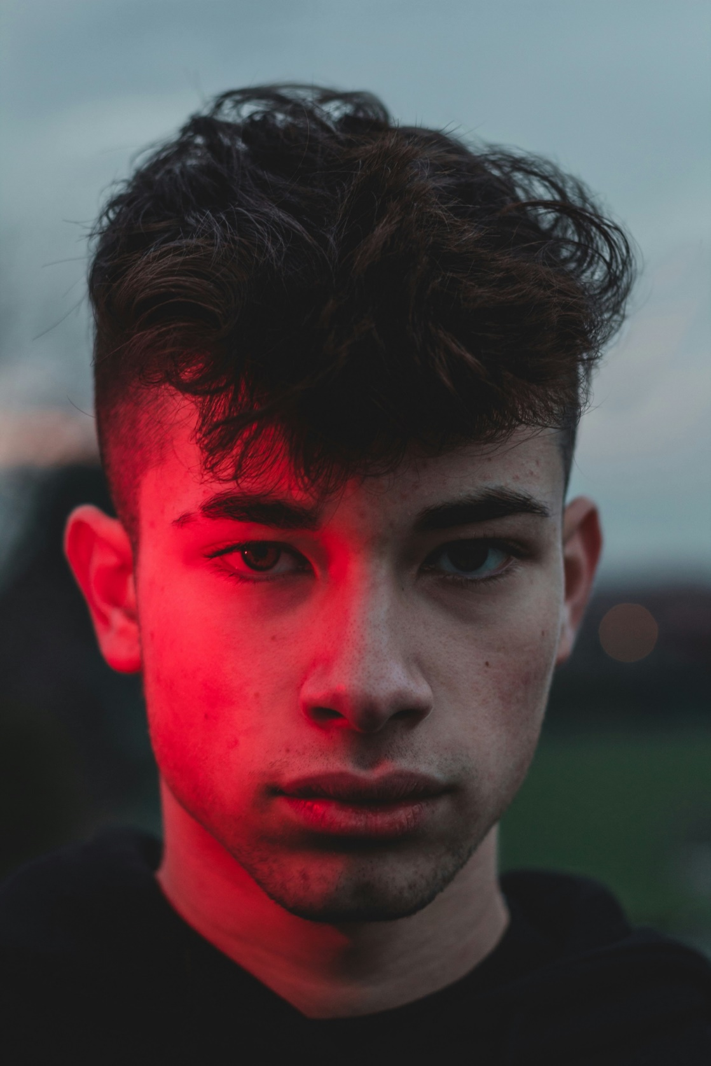
A victim’s quote
“The grooming’s so strong that rewards seem worth the risks. It seems better to stay away from parents and go with this “new family” that are going to look after you and provide for you...
…In the end, THEY DON’T”
It’s grooming | it’s child trafficking | it’s child criminal exploitation.
Notes:
A quote which sums up how young people are drawn into county lines and pointing out the dangers of getting involved in county lines and other forms of modern slavery,

Slide 29
Spotting the signs of exploitation
Do you feel unsafe right now? Are you afraid something bad is going to happen very soon?
Have you been asked to do something illegal, or that seems wrong, but you feel you can't say no to?
Do you feel like you have no choice but to keep doing something you don’t want to do, due to pressure or threats?
Has anyone promised you something (like money, a job, or gifts) in exchange for doing something that makes you uncomfortable?
Has someone made it difficult for you to stay in contact with friends and family, or pressured you to lie or keep secrets?
Notes:
These are 5 questions from the Causeway Exploitation Risk Checker. There are 9 in all and are included in the Facilitators Notes and the handout for the young people. Point out the full list in the young person’s handout.

Slide 30
Act or Ignore
Choose one side of the room to move to in each scenario.
You’re welcome to change sides at any point.
Act
Ignore
Be honest!
Notes:
If possible spend 15 mins on this exercise. Divide the class into 3 groups and each group discuss one of the questions on the next slide and on their handout.

Slide 31
Group 1
Group 2
Group 3
You notice one of your friendship group has a new mobile phone, that they haven’t given you the number for. They seem a lot busier and have much less time to see you.
You notice they hang out with different people, who aren’t in school.
Recently, a girl in your friendship group has been missing quite a bit of school. When they are at school, they are sometimes collected by a man, driving a car who you know is not a family member.
A friend of yours had a message on Insta asking them to hold on to a bag.
The person messaging said they’d give your friend some cash once they get it back as long as it’s kept secret.
Act
Ignore
Notes:
Introduce the three questions
There is a hand out at the end of the Facilitators notes that you can give to the class. If you would rather use an alternative exercise, choose from the slides following this exercise.

Slide 32
Discuss with those around you:
Why would you act?
Why is it your responsibility?
What would you do?
Why would you ignore this?
Whose responsibility is it?
What worries you?
Notes:
As a group they discuss whether they act or ignore the situation and reasons for doing so as well as their concerns.

Slide 33
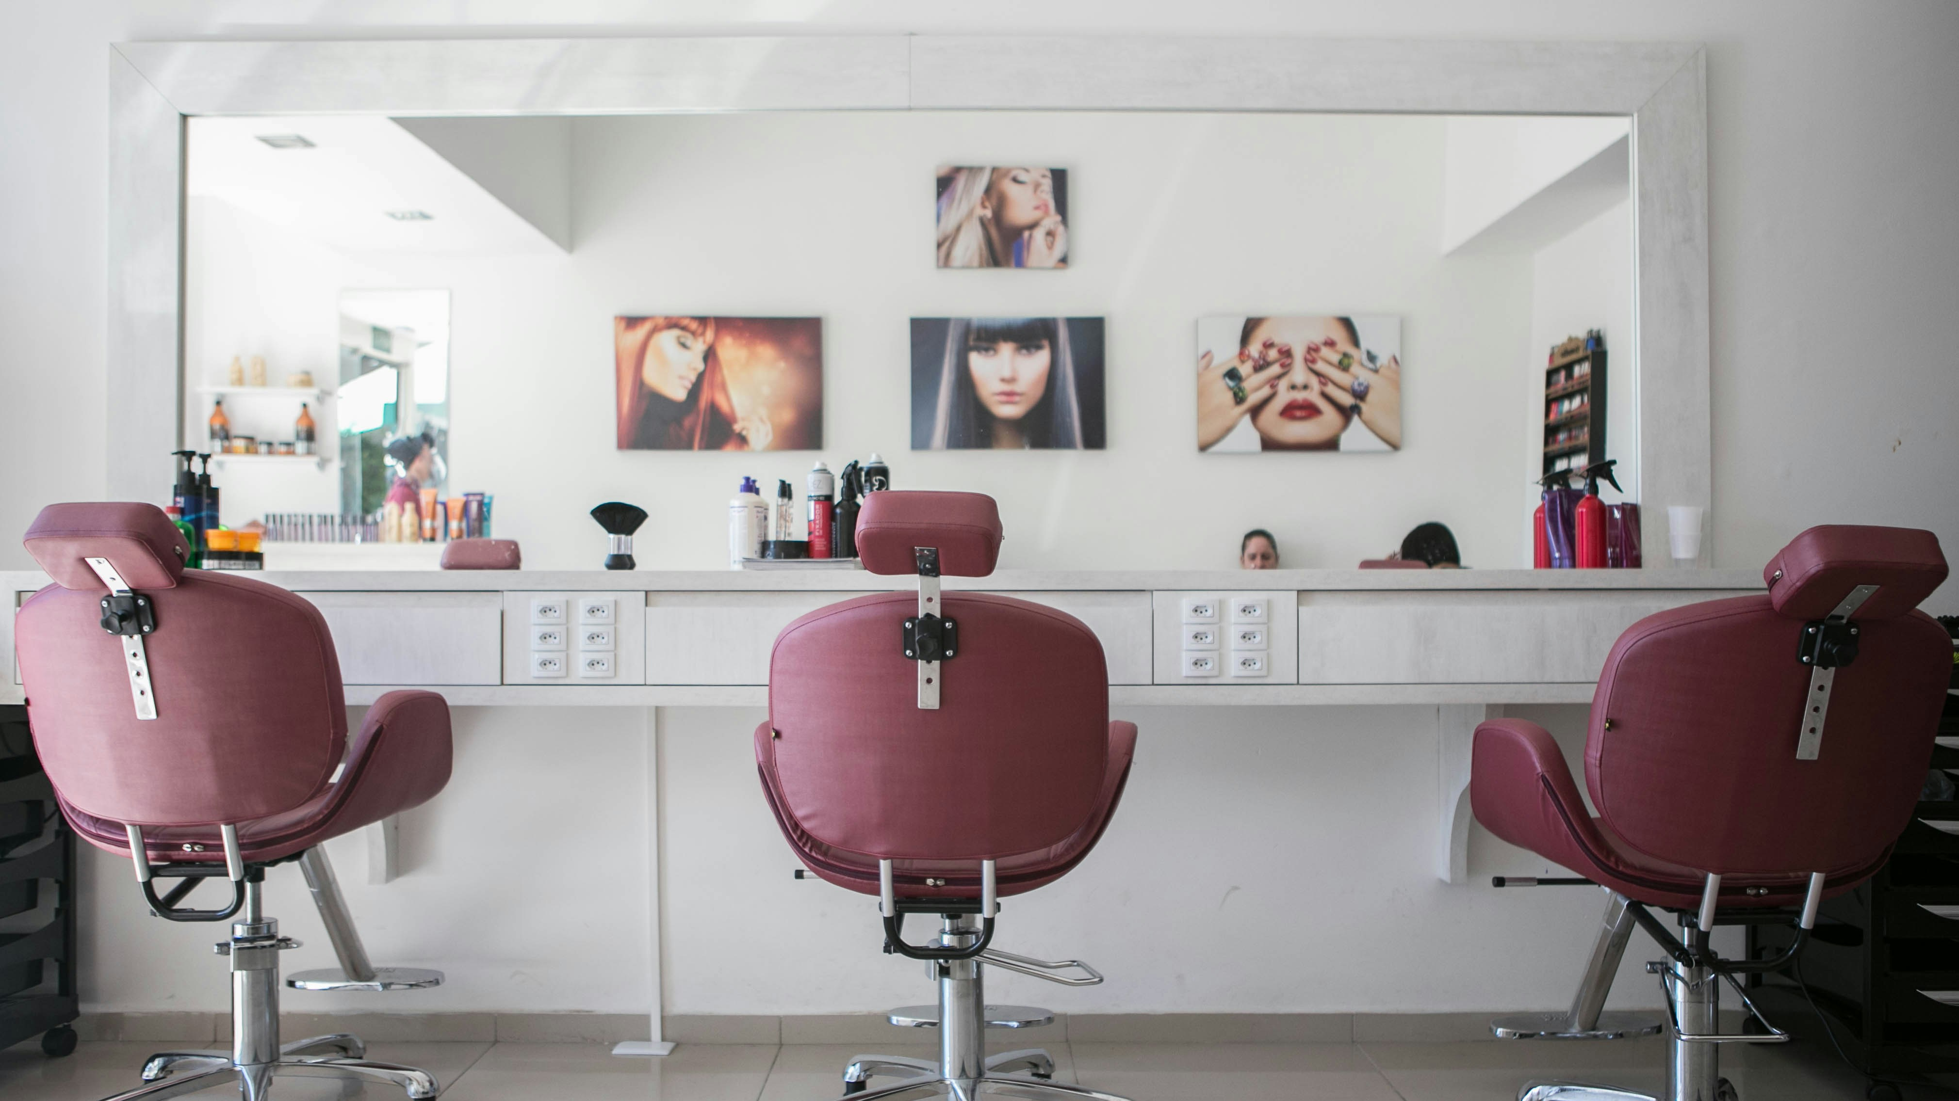
Extra exercise – how this relates to our everyday lives
Going to the Nail Bar
Notes:
Read the narrative about trafficked nail bar workers.

Slide 34

Extra exercise: What is going on behind closed doors?
How would you feel?
How do you think people are tricked into this kind of work?
Notes:
Read the narrative about those caught up in domestic servitude. Then ask the questions on the slide which apply to the nail bar and the domestic servitude situations:
Q) How would you feel?
Q) How do you think people are tricked into this kind of work?

Slide 35


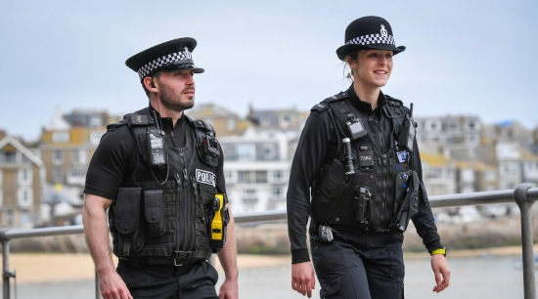



Where to go for help
Choose whoever you feel most comfortable speaking to
Teacher | Head of year | Tutor | Pastoral Lead
Police Officer | PCSOs | Police volunteers
Trusted adult
fearless.org
Notes:
In the previous activity they will have talked about going to others for help. Here are some useful suggestions. Please note the Schools Community Police Officer might be called something else by the relevant police force or they might be volunteers. It is best to check with the school first. Children and young people should be strongly encouraged to use these forms of help rather than keep their concerns to themselves. Reassure children of their anonymity and confidential nature of anything they share with others.

Slide 36

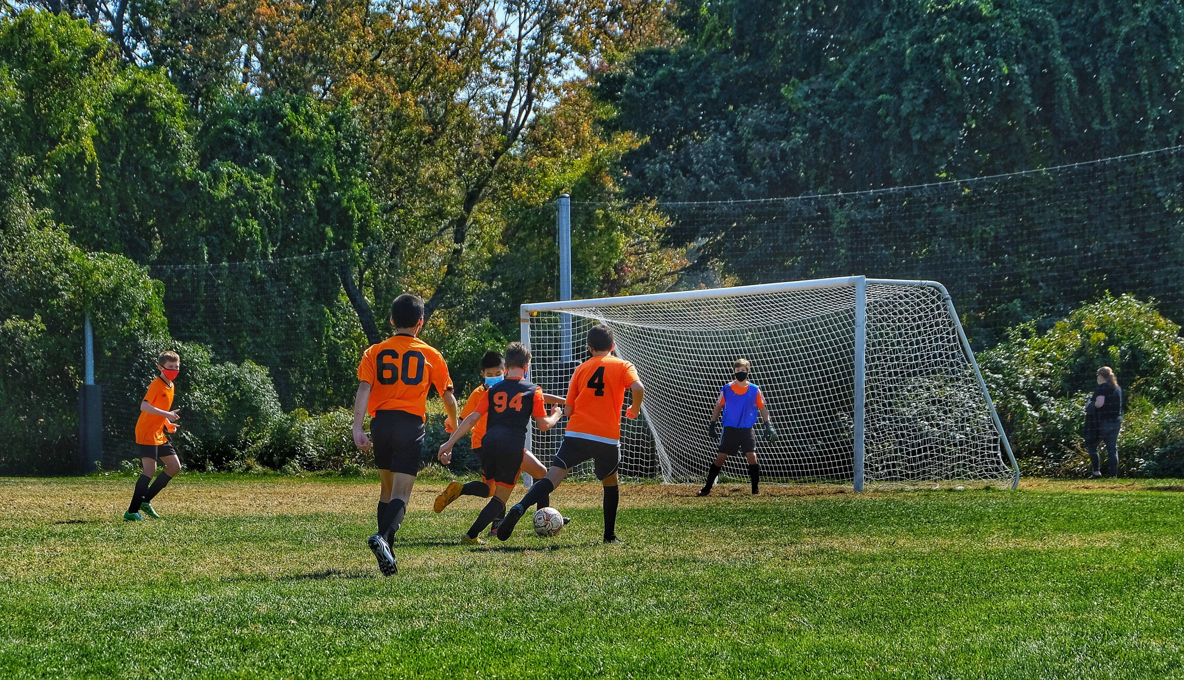
3 key areas for yourself and your friends to think about in order to be safe
Your online activity
Your friendships
Your wellbeing
Notes:
Just mention these areas of self care and point out some of the examples in the Facilitator’s notes.

Slide 37

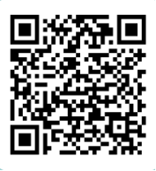
https://forms.office.com/e/sv0f2HJf67
You are unique and gifted in ways that can make you happy and make a difference to our world.
You have your whole life ahead of you.
Live it to the full!
Notes:
A positive encouraging quote to end the session, reminding each young person of their potential.

