Slide 1



Tackling Modern Slavery
in the Care Sector
Notes:
Draw attention to safeguarding issues – some of the material may be upsetting

Slide 2
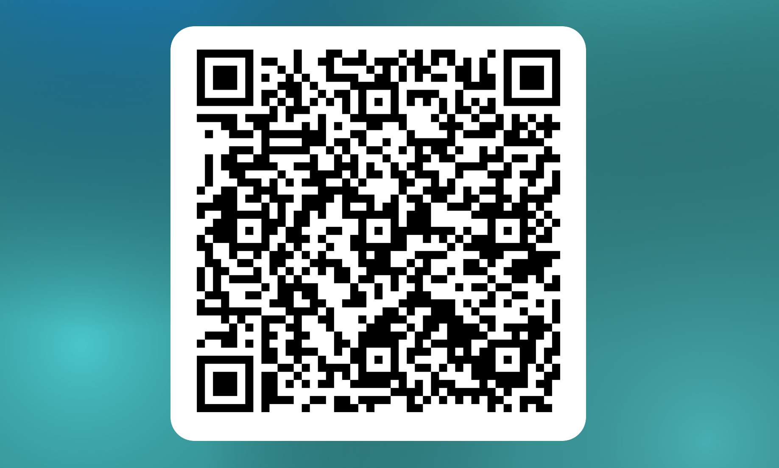
Welcome and Introduction
Registration form
Course Objectives
How to spot the signs and indicators of the different types of exploitation that exist within modern slavery and human trafficking
How to recognise signs of control and abuse that could be taking place for you or amongst those that work for you/colleagues within the care sector
How to report to the authorities an incident of modern slavery and/or human trafficking
Notes:
Draw attention to safeguarding issues – some of the material may be upsetting

Slide 3

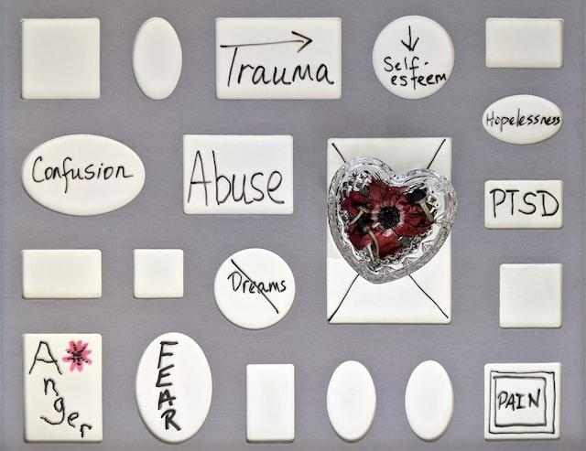
Safeguarding on this course
Some of the content we discuss may be distressing.
Look after your own emotional wellbeing.
If you want to leave, please do, BUT talk to a staff member or find someone to offer support before leaving here today.
Notes:
This is a key point to emphasise . There are a number of videos and case studies which trigger memories of bad experiences in the past or just might be upsetting because of the nature of the content and information. Participants should be reassured that it is OK to leave the room if they need time out or need to contact someone to process what is going on for them.

Slide 4


Question – discussion in pairs
What do you think of when you hear the term Modern Slavery?
Volunteers to share thoughts/write a few key words in the chat
Notes:
Draw attention to safeguarding issues – some of the material may be upsetting

Slide 5
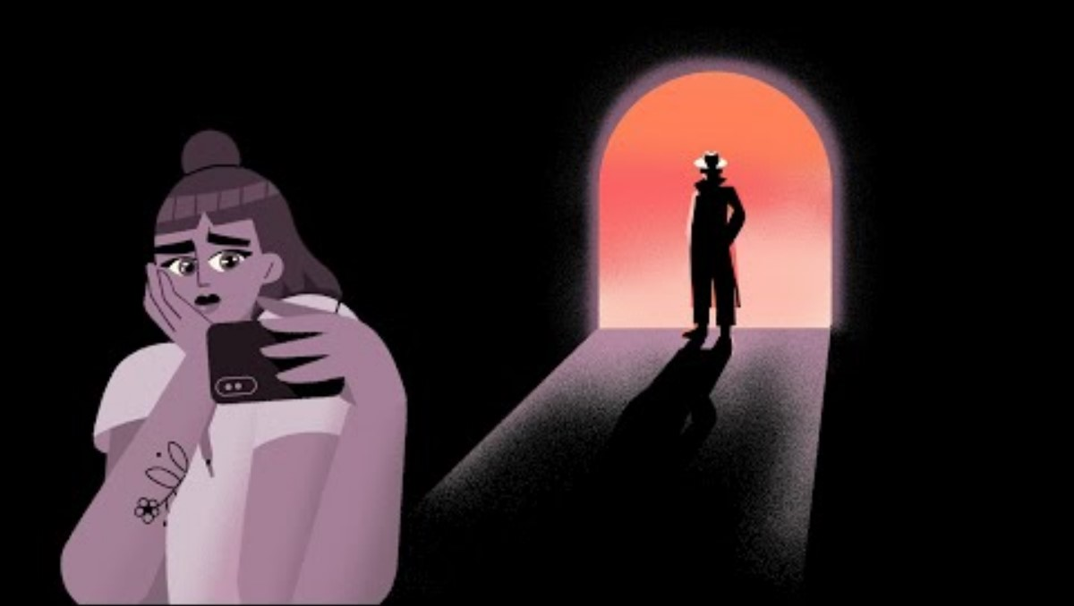
Notes:
Draw attention to safeguarding issues – mention before playing the clip that some of the material may be upsetting

Slide 6
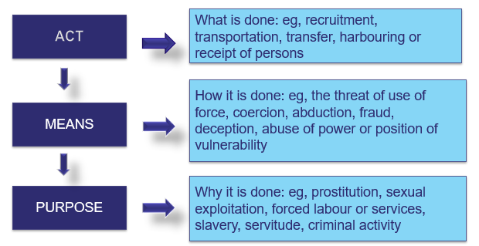

Part 1: Introduction to Modern Slavery
Overview of Introduction
International definition for human trafficking

Slide 7



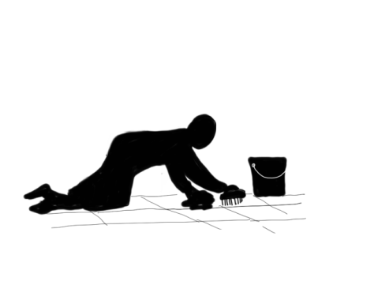
Forms of modern slavery
Domestic servitude
Sexual
exploitation
labour
exploitation
Criminal
exploitation
Forced to work in a private household
Exploited by a partner or relative
Childcare, cleaning, ironing and all household tasks
Long hours, little to no pay
Non-consensual and abusive sex acts
Child sexual exploitation by group or individual
Sex work in fixed or changing location
Trafficking for personal gratification
Made to work long hours, in hard conditions
No training or equipment
Forced to hand over wages to traffickers
Forced to participate in illegal activities: pick-pocketing, shop-lifting, cannabis cultivation, begging
Increase in child criminal exploitation or ‘county lines’ (no force required)
Financial exploitation, sham/forced marriages

Slide 8

Overview of
Understanding modern slavery
Exercise - Where are some of the locations that this exploitation could take place?
Car washes
Restaurants
Nail bars
Traveller sites
Factories
Brothels
Private dwellings
Farms
Cannabis Farms
Care Homes
Recycling Sites
Fishing Industry
Building Sites
Hotel / holiday home
Employment agencies
On-street begging
Notes:
Start with a brainstorm and then reveal

Slide 9
Overview of
Understanding modern slavery
How offenders exert control
Exercise: Identify the ways in which exploiters exert control over those they seek to enslave or for trafficking
Coercion through fear
Intimidation
Use of force
Blackmail
Fear of authorities
Exploiting vulnerability
Removal of control
Isolation
Remove travel documents
Removal of self-esteem
Debt bondage
Sexual assaults
Notes:
You could ask for ideas if there is time.

Slide 10
Understanding Modern Slavery
The indicators of exploitation
No passport or ID
Movement controlled
Limited social contact
Restricted freedom
Controlled by another
Poor language skills
Reluctant to give details of accommodation
Behaviour
Bonded by debt
Money deducted from salary for food or accommodation
Dependent on others
Finances
Lack of access to medical care
Unexplained injuries
substance dependent
Appearance
Notes:
This is not an exhaustive list.
Illegal entrant
Poor standard accommodation
Threats of being handed over to authorities
Working in location likely to be involved in exploitation

Slide 11
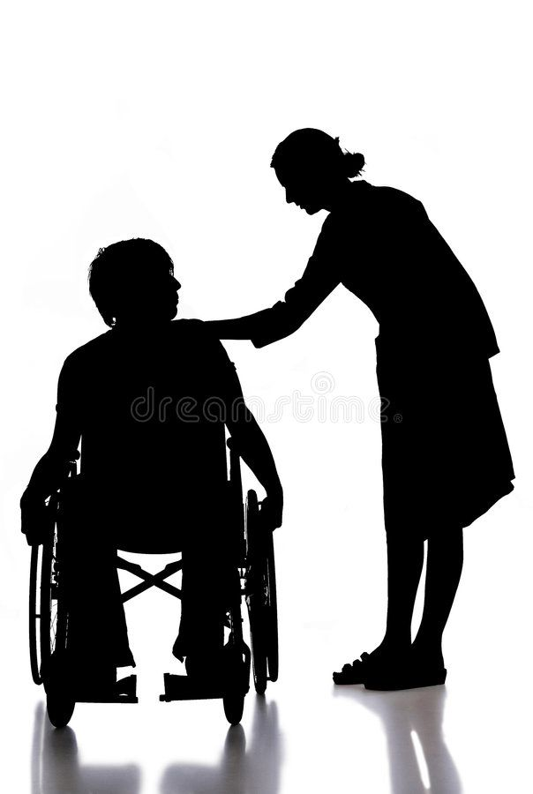


Modern Slavery in the Care Sector
Exploitation of care workers
Safeguarding risks
to residents
Risk in organisational
compliance
Notes:
When you look at the care sector there are three elements that are all inter-related as they are on the same geographical site. When concerns are raised about exploitation of workers it has an impact on the other two elements and should not be treated in isolation.

Slide 12
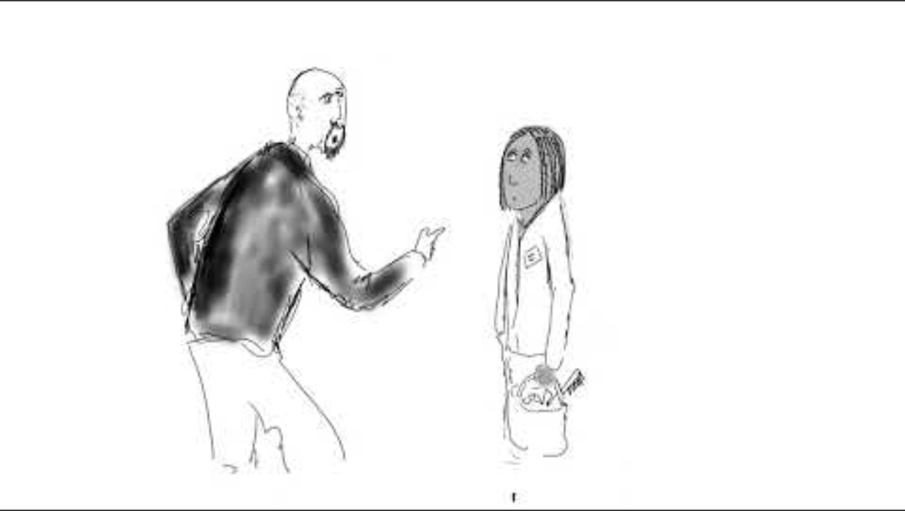
Case study: Terri’s story
<<Embed Youtube link to animation>>
Questions:
In what ways was Terri vulnerable to Modern Slavery?
What are the control indicators?
Source https://www.bbc.co.uk/news/uk-66260064
Notes:
Mention before playing the clip that some of the material may be upsetting. Play the video and discuss in BO groups are small groups as with the Horse trading video. Feedback to the plenary or the whiteboard. Then consolidate by showing the next slides.

Slide 13
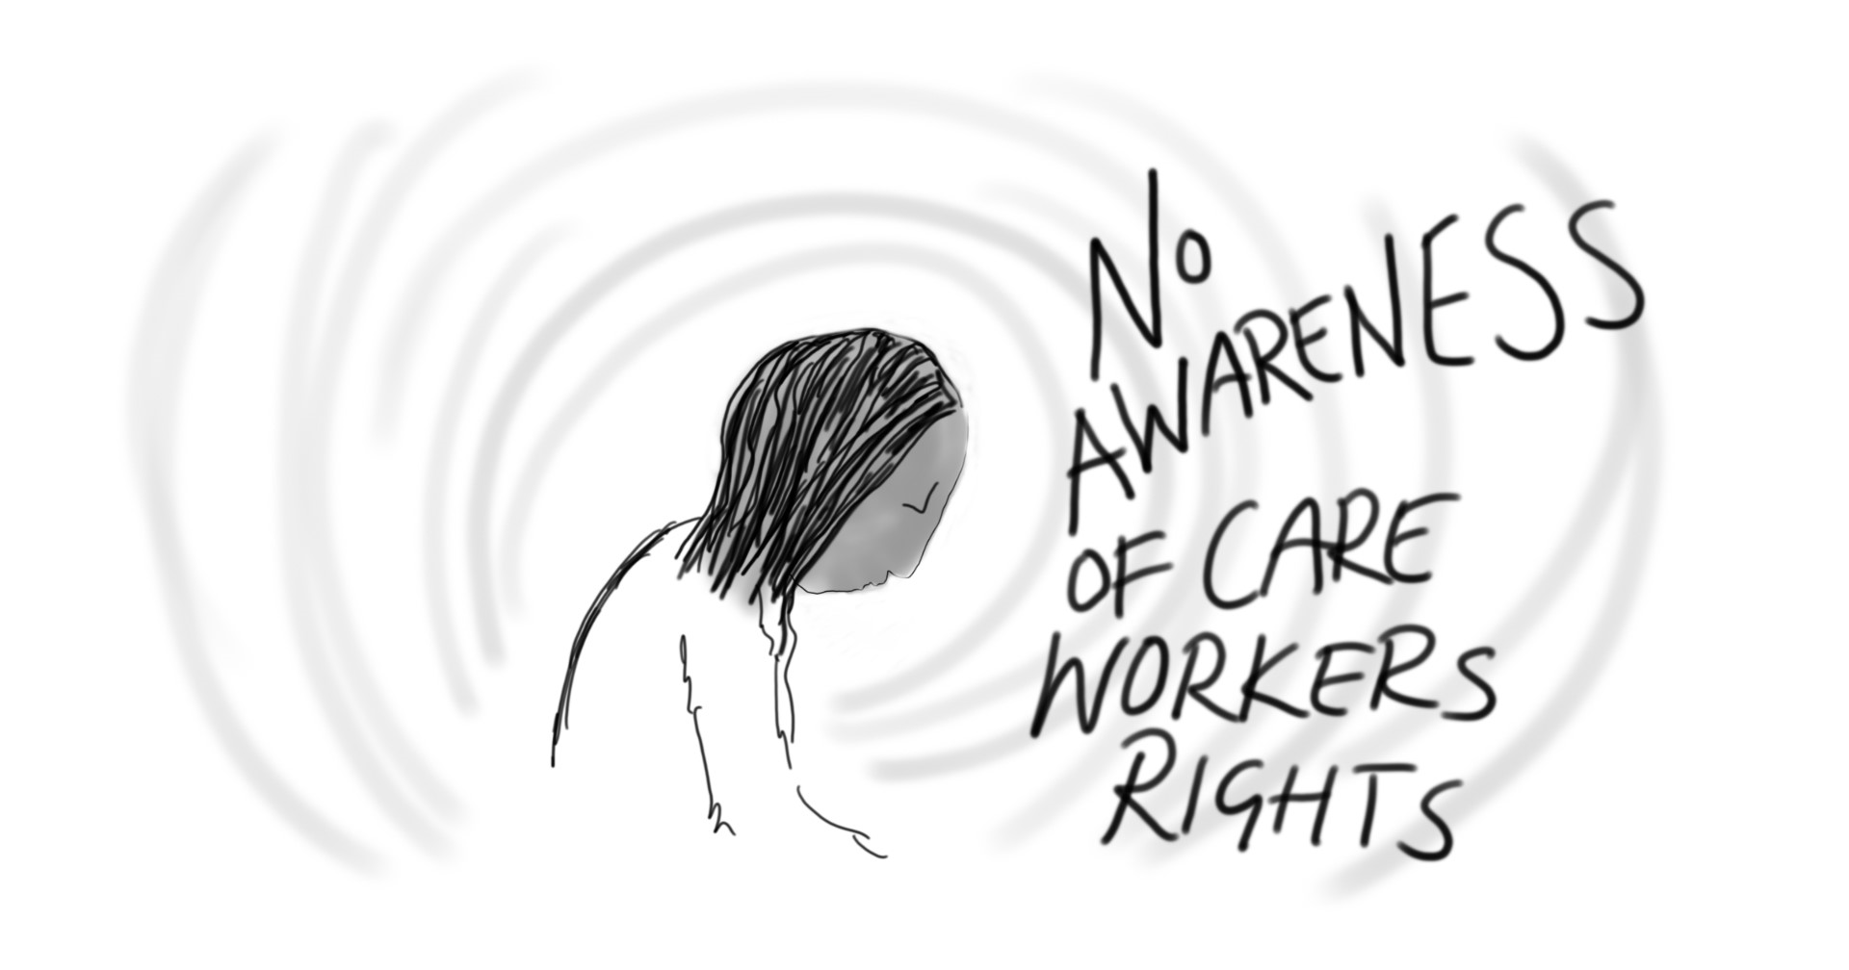
Case study: Terri’s story
In what ways was Terri vulnerable to Modern Slavery?
Bad marriage – desire to escape
Not aware of rights
Dependents
Poor economic status
What are the control indicators?
False promises
Debt bondage
Threats to stop work and cancel visa
Threats of violence
Threats if you complain/report
Working unreasonable hours
Poor working conditions
Unrealistic expectations
Notes:
Draw attention to additional insights coming from the group

Slide 14
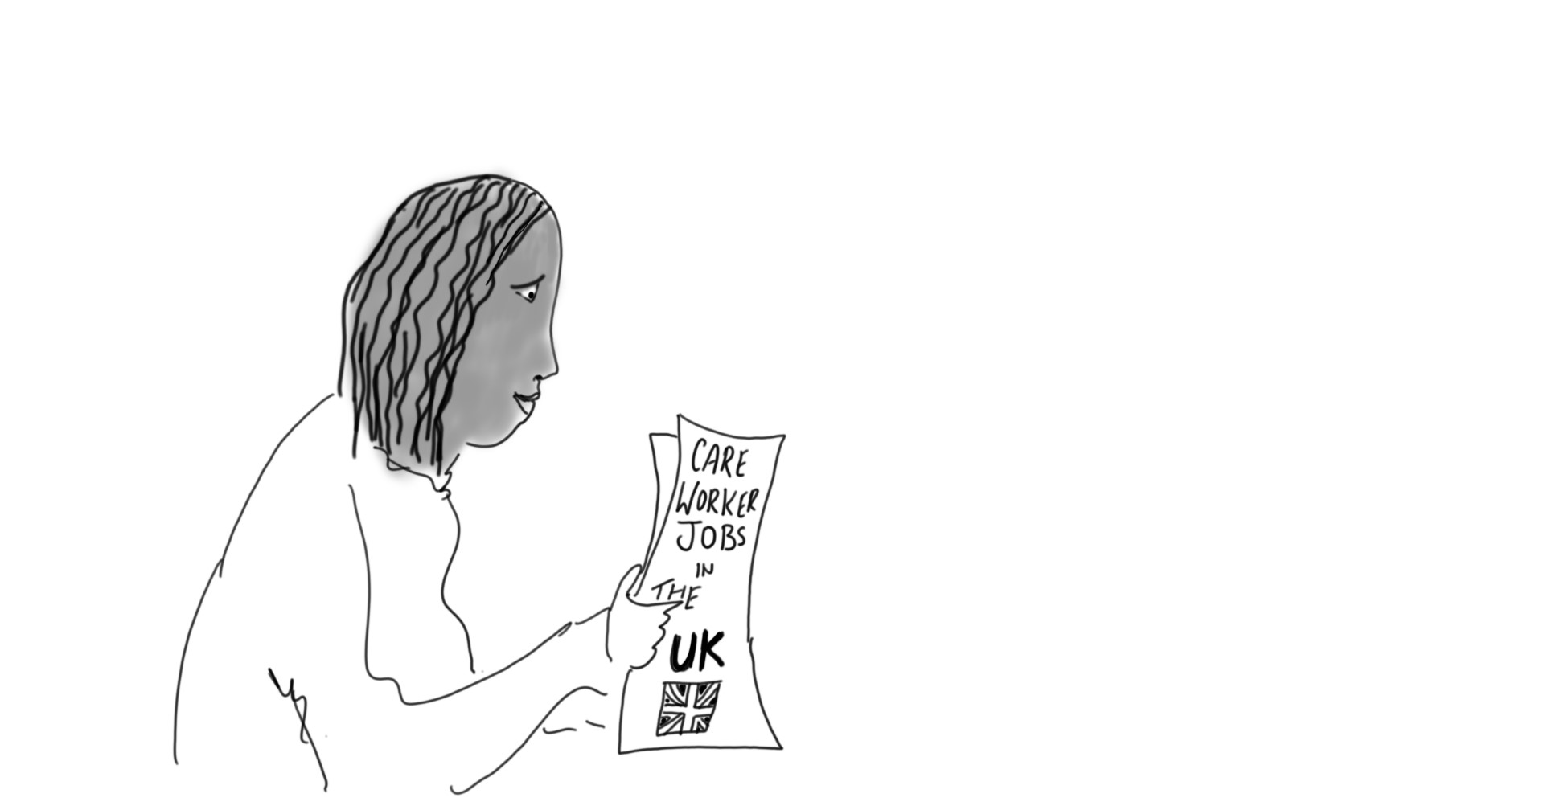
Methods of Recruitment
Job offers or advertisements
Direct recruitment by care company
Third party recruitment agencies – online or at recruitment agency office
False promises are common – appealing to individuals’ planning to emigrate for a better life (car, driving lessons,)
Offers of accommodation are frequent
Exploiter posing as a benefactor
Recruited by exploiters who had ties to their own country
Notes:
Talk through this slide

Slide 15
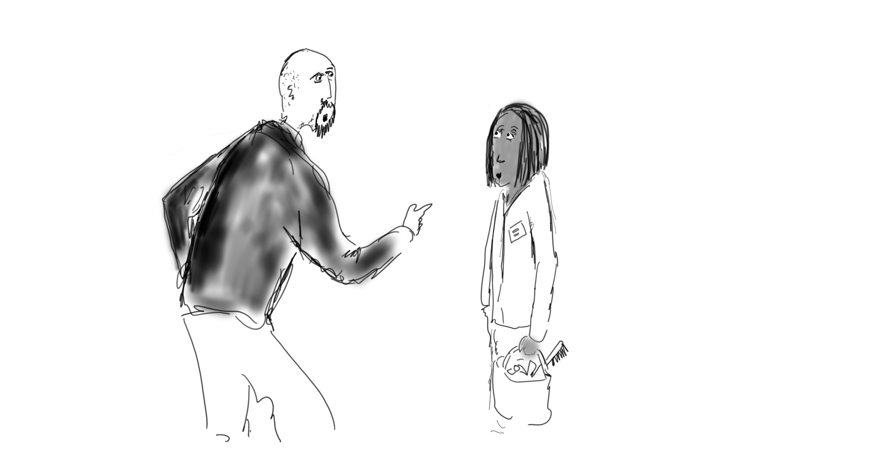
Methods of Control
Financial
Withholding of wages,
Debt bondage
Excessive fees for breaking contract
Accommodation and hours
Made to work excessive hours and without days off
  Living conditions often poor and overcrowded
Confinement or restricted movement
Transport arranged by exploiter – also charged and deducted
Sometimes prevented from going to places of worship or medical appts
Threats
to revoke certificates of sponsorship,
to be deported,
to be reported to the police or DBS or to family members
Physically or verbally abused if they complain
Monitoring
  Via CCTV or GPS - or phone calls or text messages
Important documents withheld or destroyed
Isolation
Prevented from communicating with colleagues, friends or family

Slide 16
Scams
Fee scam
Payment of exorbitant fees to secure a job in the UK.
Contract scam
Excessive and unreasonable repayment clauses
Job scam
Job differs from what was promised – conditions, hours pay
Visa scam
Recruited on a different visa – student visa 20 hours a week maximum
Impersonation scam
Someone posing as a UK Visa and Immigration officer, asking you to pay costs
Document scam
Promised a guaranteed pass rate for a qualification or a fake qualification
Identity scam
Sharing sensitive information - age, birth date, or bank account details prior to a job being secure
Source : Sandwell Anti- Slavery partnership Responding to Modern Slavery in the Care sector

Slide 17
Employment rights in the UK
Nat. Min. Wage
Skilled care workers on visas entitled to Nat. Min. Wage or Nat. Living Wage
Itemised payslips
Employers need to provide payslips with gross and net pay
Working hours
Skilled care workers on visas to work a minimum 39 hours/week and if more than 6 hours/day – 20 mins break min.
Annual leave
Min. number of paid holiday weeks per year for all skilled care workers on visas
Deduction from wages
Employers can only make specific deductions and must be itemised on payslip
Sick pay
Outlined in contract, including Statutory Sick Pay for 4 or more days absent
Health & safety
Employers' responsibilities. Training and protective equipment to be provided
Source : Sandwell Anti- Slavery partnership Responding to Modern Slavery in the Care sector

Slide 18

Spotting the signs
What are the indicators that someone is being exploited in the care and health sector ?
Feel free to write a few key words in the chat
Notes:
Brainstorm – ask the group for ideas first before revealing the next slide

Slide 19
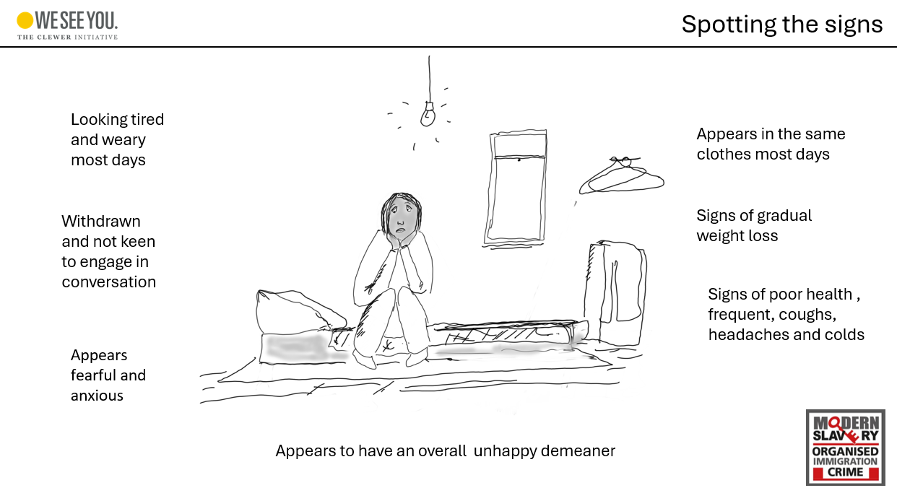

Slide 20

Scenario – Residential Care home worker
You have just started your shift and you notice another care worker in tears at the entrance to one of the storage rooms in the care home. You don’t know her very well as she is often on different shifts, but you usually say hello when you see her arrive as you head home.
When you ask her what is wrong, she initially says nothing, but then, while you are trying to find a tissue for her, she admits that she is totally exhausted.
She tells you she has worked very long shifts for the last 7 days with hardly any break. Despite this she doesn’t have enough money to send to her family back home in Zimbabwe.
At that point a senior staff member comes into the corridor and she quickly disappears into the store room to collect bed linen and pillows.
Notes:
If you are running a care home staff course go to the next slide
If you are running a non care home staff course create small groups for each of the characters and discuss how they would respond. You can use BO rooms or small groups.

Slide 21

How to respond
When something doesn’t feel right:
What have you observed or heard (questions to ask yourself not them):
about their typical working day – duration, number of clients, do they have days off?
• How do they travel between clients?
• What sort of accommodation do they live in and who with?
• Are they sending money back home to support others?
• Do they have access to their passport or other ID documents?
• Is the job what they expected it to be and if not in what way does it differ to what was agreed?
Notes:
It can be intimidating to directly question a potential victim, so it is best just to keep your eyes and ears open for signs that someone may be being exploited

Slide 22
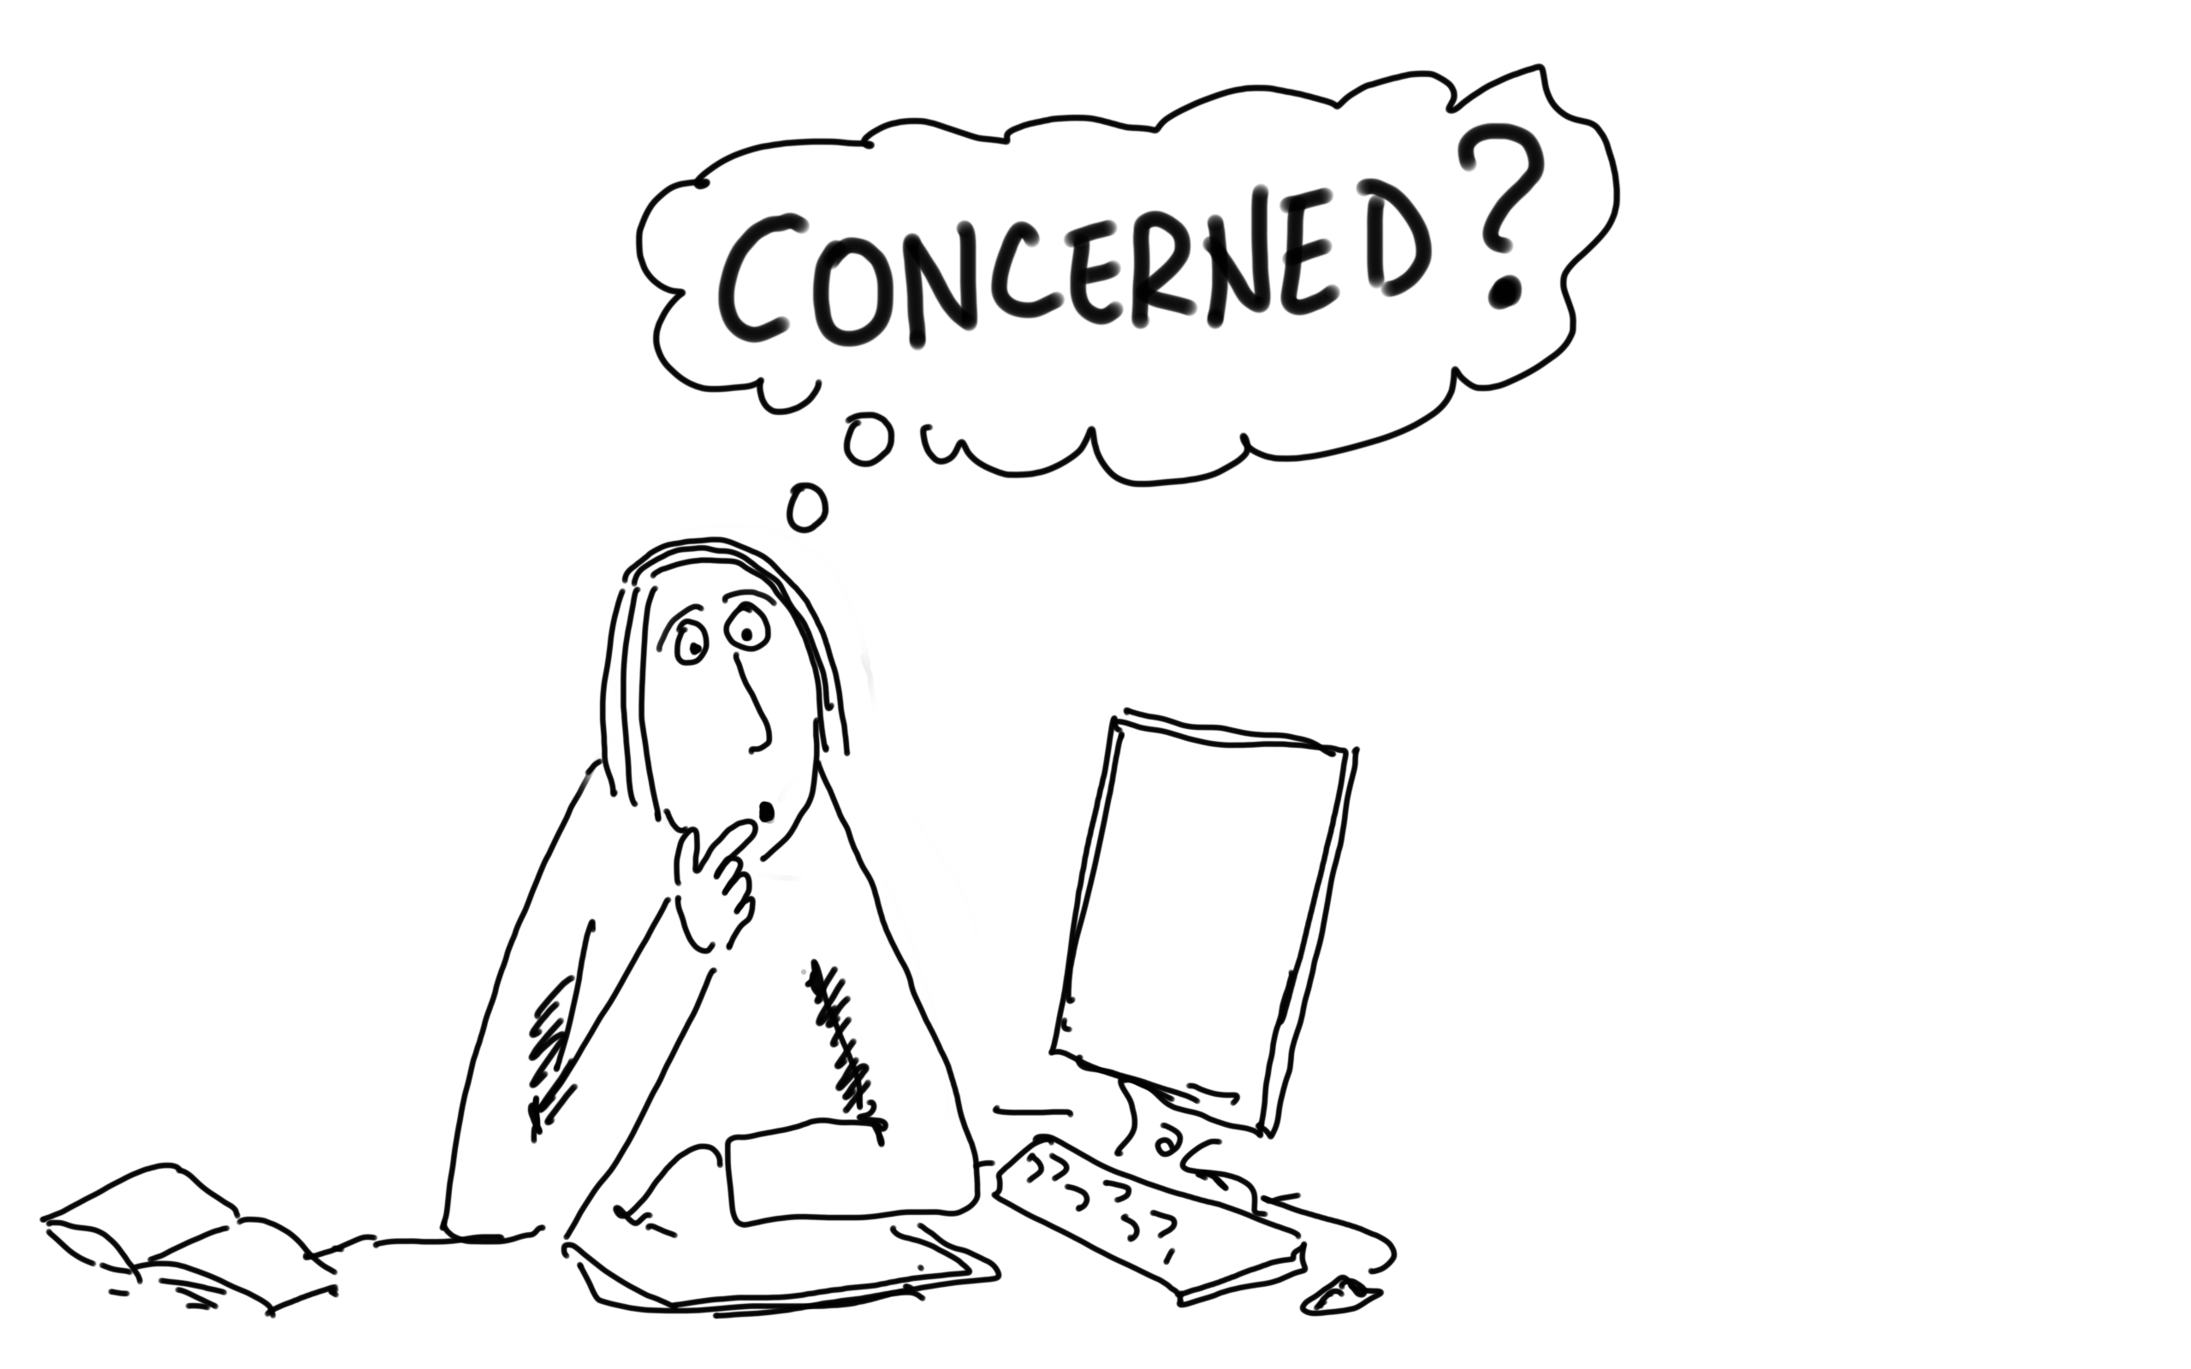
What to do if you’re concerned
Below are possible examples that you may witness
You overhear a care worker in the staffroom explain to a colleague that she is in debt to care recruiter, is isolated, no food etc
You hear a care worker being shouted at over her mobile phone, She is visibly upset stating she needs her passport back
You notice a care worker has bruising to her arms and looks tired, wearing the same clothes daily. Your colleague states they have noticed she works 7 days per week

Slide 23
Reporting if you are concerned for yourself
IF YOU
are not allowed to have your Identification Documents
are not allowed to leave your accommodation or place of work freely
have been deceived with regards to visa fees and are being forced to pay back large amounts of money to pay for the visa and travels costs.
have been promised hours that never materialised
have to pay extra charges to others in order to keep your job and/ accommodation
live in accommodation that is cold, damp, unclean and poorly equipped
are working longer hours than you expected and don’t have adequate breaks and days off
are not getting the pay you were expecting or receiving pay that doesn’t cover all your costs and needs
don’t feel safe and/or have experienced violent or verbal threats
are feeling isolated, lonely and scared
Notes:
Brainstorm – ask the group for ideas first before revealing the next slide

Slide 24
have experienced any of the statements listed,
please contact as soon as possible:
The Modern Slavery Helpline
(08000 121700) run by the charity Unseen. You can report anonymously if you prefer.
Or The Police
(999 for an emergency
101 for non-emergency)
IF YOU

Slide 25
Summary
1. Recognise that Modern Slavery is present in the Care sector and in our communities
3. Beware of the signs of someone who is caught up modern slavery
4. Know that you are not expected to investigate or act on behalf of the Police
5. If you have concerns contact :
The Modern Slavery Helpline run by the charity Unseen
(08000 121700)
Or The Police
(999 for an emergency
101 for non-emergency)
2. Raise awareness through sharing this information and through the flyers

Slide 26
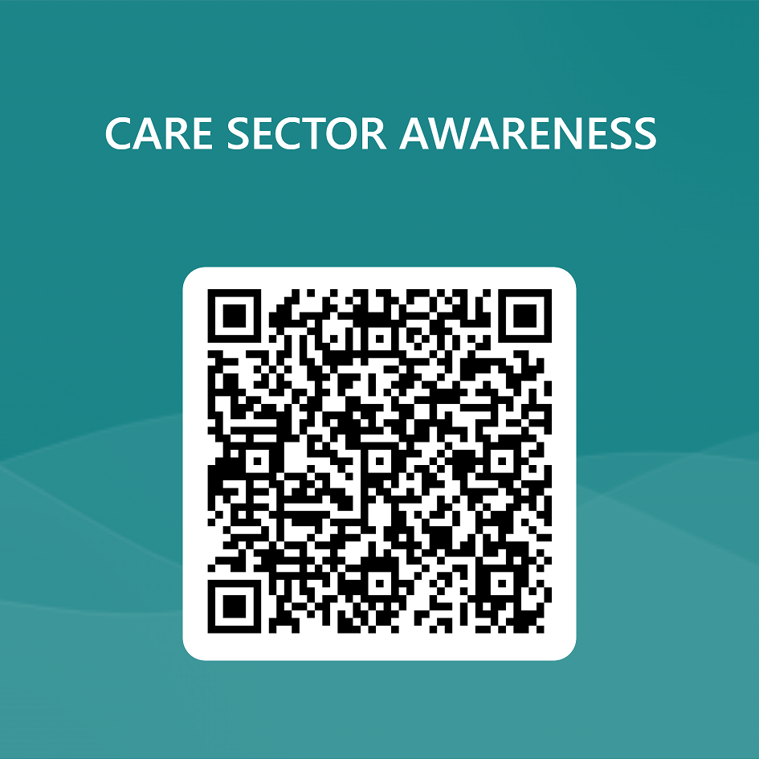

Post course evaluation
Notes:
This is a key point to emphasise . There are a number of videos and case studies which trigger memories of bad experiences in the past or just might be upsetting because of the nature of the content and information. Participants should be reassured that it is OK to leave the room if they need time out or need to contact someone to process what is going on for them.

Slide 27
Thank you for attending

Slide 28
Keeping your
Contracted care workers
safe from
modern slavery
Part 2

Slide 29
The current situation in the Care Sector
606%
increase in the number
of modern slavery care
sector cases from
2021 to 2022.
712
potential victims of modern
slavery were indicated in the
care sector in 2022, comprising
18% of all potential victims
indicated through the Helpline.

Slide 30
“The issue with care workers experiencing exploitation is that very vulnerable people are being employed to care for very vulnerable people”
Justine Carter, Director, Unseen

Slide 31

Safeguarding risks
to patients
Risks to care home residents
Risk of residents suffering distress and discomfort from lack of adequate physical and emotional care
Risk of delivering poor quality of care due to the lack of proper training, limited language skills, being overworked, low morale
Risk that exploited unqualified workers recruited as carers present a safeguarding risk
Serious Compliance issues
Notes:
Point out that this is the second element that we need to be aware of

Slide 32

Case study: Residential care home
Janet* was recruited from Zimbabwe* to work in a residential care home. She did not receive a contract, and her
employer charged her £10,000 for a certificate of sponsorship. She was then forced to work more than her agreed hours, sometimes working 18-hour shifts for up to 10 days in a row.
Janet should have been paid the National Minimum Wage. However, deductions were made from her pay to recoup the £10,000, leaving her with as little as £200 per month. On some days she could not afford to eat.
If she complained or spoke up about her rights, her employer threatened to report her to the Home Office and have her deported. They had also threatened to harm Janet and her family in Zimbabwe if she reported the situation.
The Helpline assessed indicators of modern slavery, explored support options with Janet and referred the situation to
the police, which resulted in an investigation.
*Name and other personal details changed to protect identity
Source : Unseen

Slide 33



Building a culture of prevention
g a P r e v e n t i o n C u l t u r e
The Role of Leadership and Governance
• Acknowledging that prevention starts at the top.
• Emphasising the responsibility of leadership in setting the tone.
• Promoting transparency, accountability, and ethical decision-making.
• Ensuring governance structures that prioritise safeguarding and human rights.
Ethical Practices and Organisational Values
• Defining and upholding clear ethical principles.
• Embedding respect for human rights in the organisation's values.
• Aligning practices with a commitment to combating modern slavery.
• Demonstrating a strong stance against exploitation and unethical conduct
Employee and Contractor Awareness and Training
• Recognising that every member of the organisation plays a role.
• Providing comprehensive training on modern slavery awareness.
• Ensuring that employees and contractors understand their responsibilities.
• Encouraging a culture of vigilance and reporting.
Source : Sandwell Anti- Slavery partnership Responding to Modern Slavery in the Care sector

Slide 34
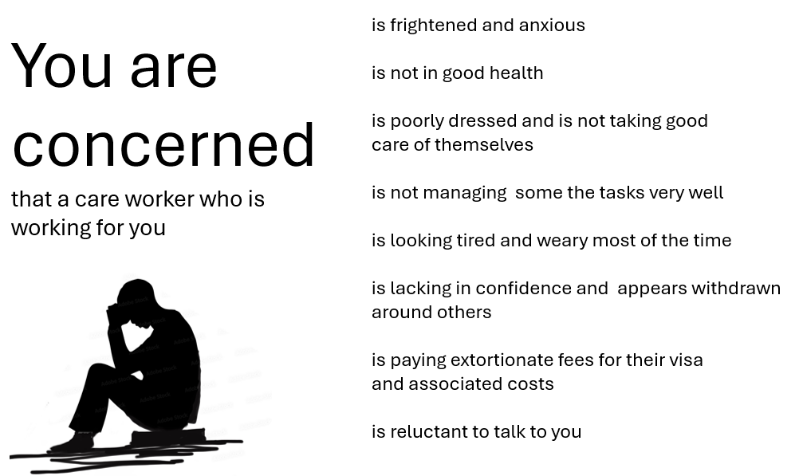
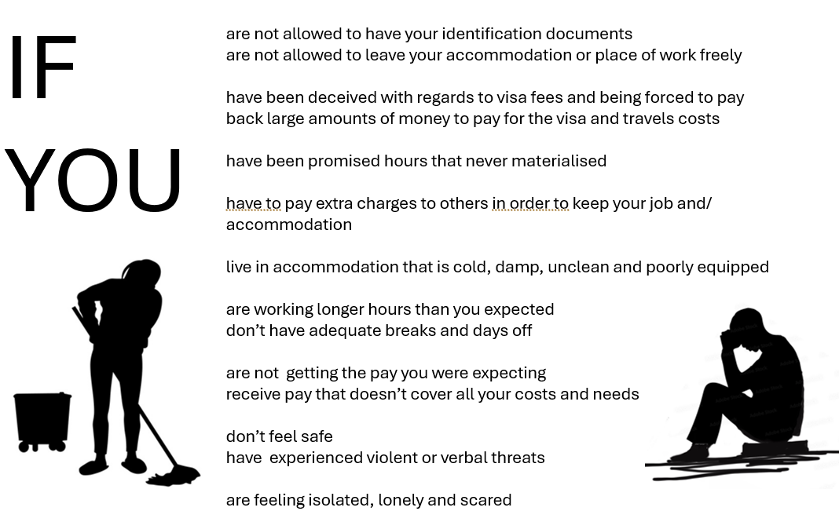
Raising awareness initiatives

Slide 35

Organisational Checklist
Reporting Procedures and Channels:
☐ Are there well-defined procedures for staff to report suspicions or concerns related to modern slavery?
☐ Does the organisation offer confidential channels for reporting, protecting whistle-blowers from potential retaliation?
☐ Are reporting mechanisms easily accessible to all employees and contractors?
Collaborating with Relevant Authorities:
☐ Does the organisation collaborate with local law enforcement agencies when modern slavery concerns are raised?
☐ Is there cooperation with relevant regulatory bodies or government agencies involved in anti-slavery efforts?
☐ Is there a process for sharing relevant information with authorities while respecting privacy and confidentiality?
Victim Support and Safeguarding Measures:
☐ Are staff trained to identify potential victims of modern slavery and to handle such cases sensitively?
☐ Does the organisation have links to support services for victims and survivors of modern slavery?
☐ Are safeguards in place to protect the safety and well-being of potential victims, including access to counselling and legal support
Source : Sandwell Anti- Slavery partnership Responding to Modern Slavery in the Care sector

Slide 36
Exploitation Care Home Compliance Care Workers on Visa Sponsorship
The former Home Secretary James Cleverly on the 4th December 2023 gave a statement to the House of Commons on legal migration. In this statement he set out the requirement for "care firms in England to be regulated by the Care Quality Commission in order to sponsor visas".
This will mean that only health and care organisations that fall under the scope of the CQC regulations are able to sponsor care worker visa applications.
All providers of health and social care who deliver services that fall within the scope of our regulation as set out under the Health and Social Care Act 2008 are already required by law to be registered with CQC.

Slide 37
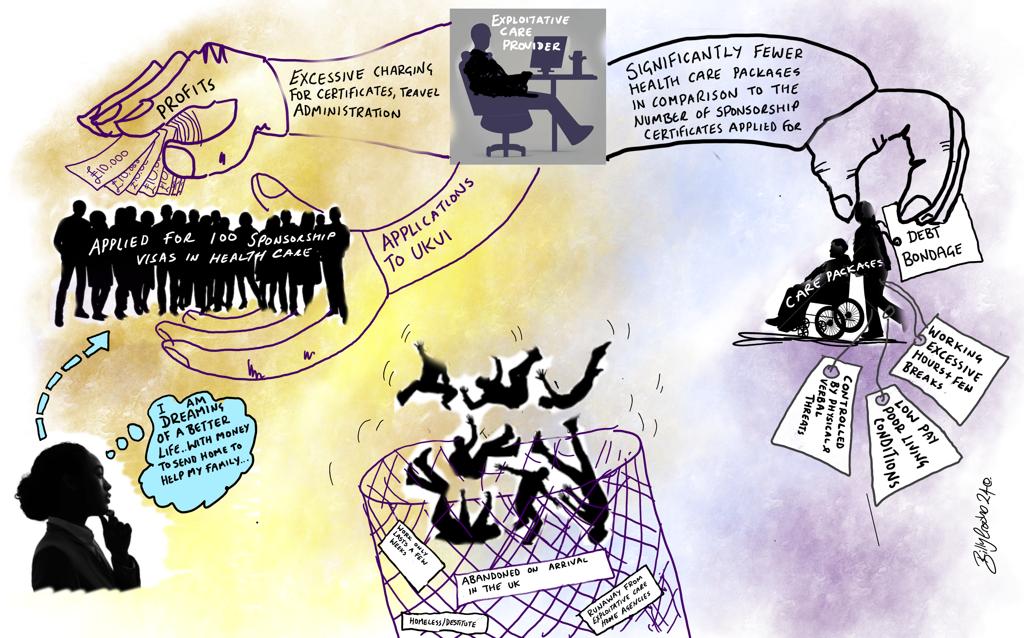

Slide 38
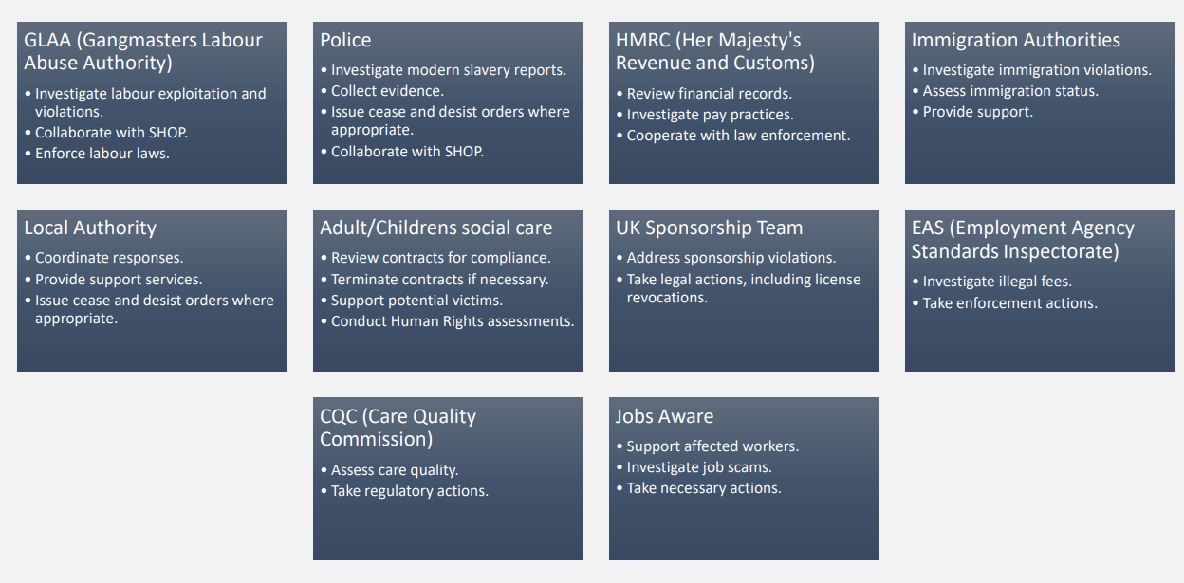
Key Agencies and actions : Addressing concerns in Care Providers
Source : Sandwell Anti- Slavery partnership Responding to Modern Slavery in the Care sector

Slide 39

Further links
Code of practice for international recruitment:
Code of practice for the international recruitment of health and social care personnel in England - GOV.UK (www.gov.uk)
International recruitment toolkit:
https://www.skillsforcare.org.uk/resources/documents/Recruitment-support/International-recruitment-toolkit-March-2024.pdf
Tips for staff retention:
https://careprovideralliance.org.uk/workforce-top-tips-for-retention-cpa-lga-briefing
Report on prevention of exploitation in the care sector:
Joint Position Paper on Preventing Exploitation in the Adult Social Care Sector – FLEX (labourexploitation.org)
Directory of licensed Health and Social Care Visa sponsors:
https://autonomy.work/care-visa-sponsor-database/

Slide 40
Final thoughts
It ought to concern every person, because it is a debasement of our common humanity.
It ought to concern every community, because it tears at our social fabric.
It ought to concern every business, because it distorts markets.
It ought to concern every nation, because it endangers public health and fuels violence and organized crime.
I’m talking about the injustice, the outrage, of human trafficking, which must be called by its true name - modern slavery.
Barack Obama

Slide 41
Post course evaluation
Notes:
This is a key point to emphasise . There are a number of videos and case studies which trigger memories of bad experiences in the past or just might be upsetting because of the nature of the content and information. Participants should be reassured that it is OK to leave the room if they need time out or need to contact someone to process what is going on for them.

Slide 42
Thank you for attending

